Slide 1
A 42-year-old woman with left facial sweating while eating
Teaching NeuroImages
Neurology
Resident and Fellow Section
© 2019 American Academy of Neurology

Slide 2
Vignette
A 42 year-old woman presented with a complaint of left facial sweating whenever she ate.
The symptoms started 6 months after surgery for a benign left parotid tumor.
There was no anisocoria or ptosis suggestive of a Horner syndrome.
Minor’s starch-iodine test was performed, revealing areas of abnormal sweating (Figure 1).
Two weeks following intradermal injection of botulinum toxin targeting the areas of hyperhydrosis, the symptoms resolved and repeat Minor test revealed resolution of abnormal sweating (Figure 2).
Shcherbina A, et al.
© 2019 American Academy of Neurology

Slide 3
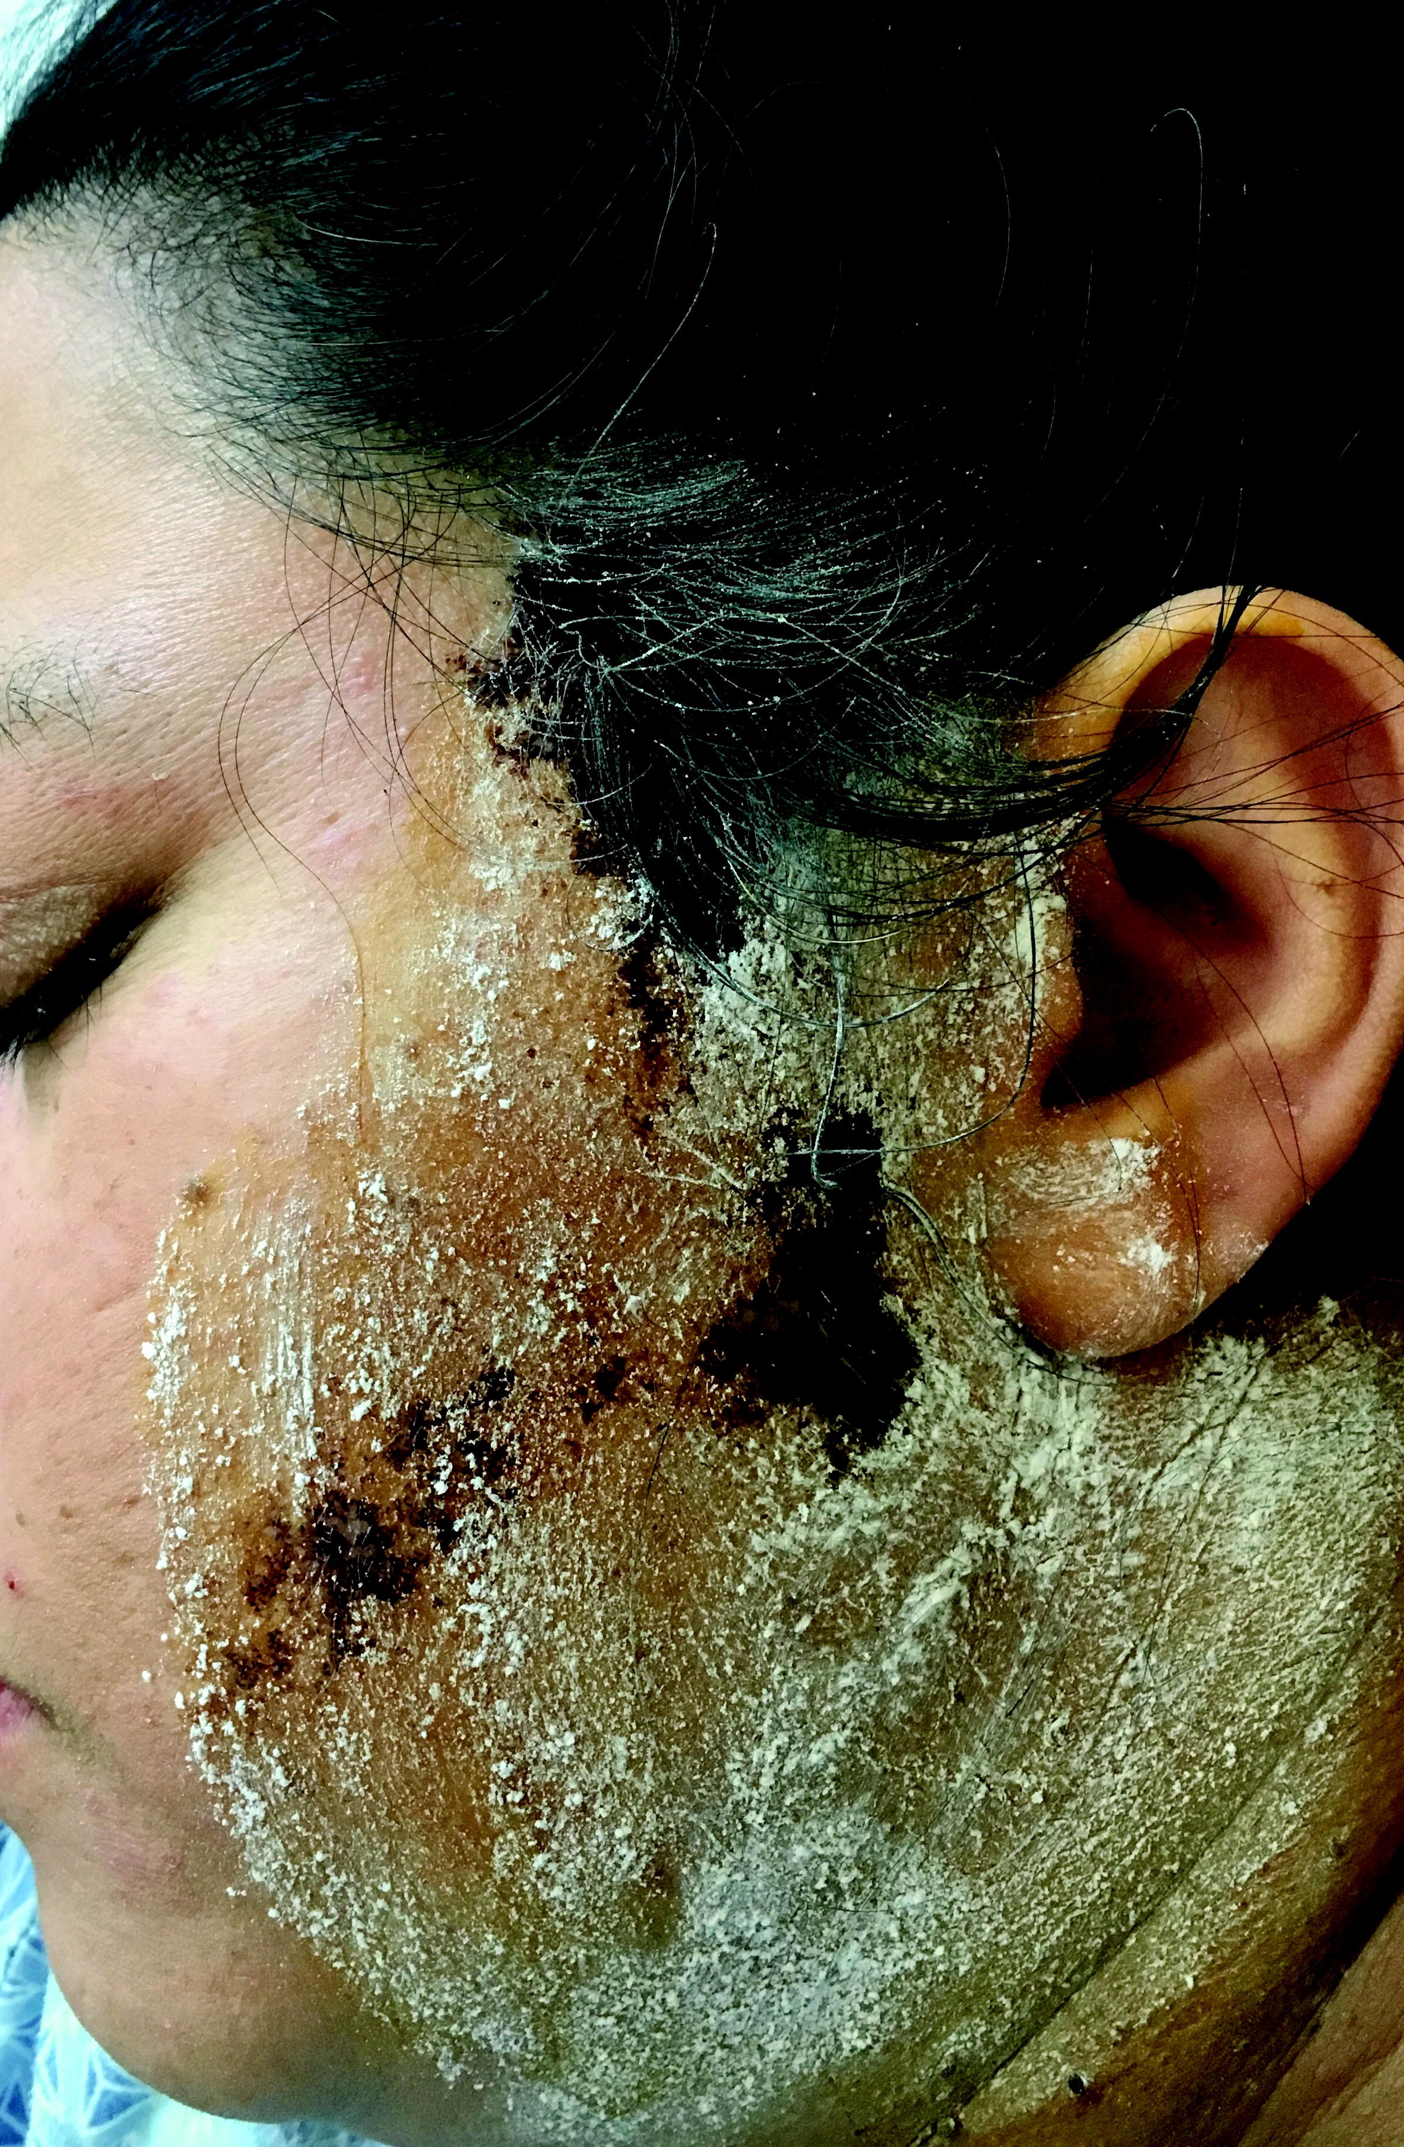
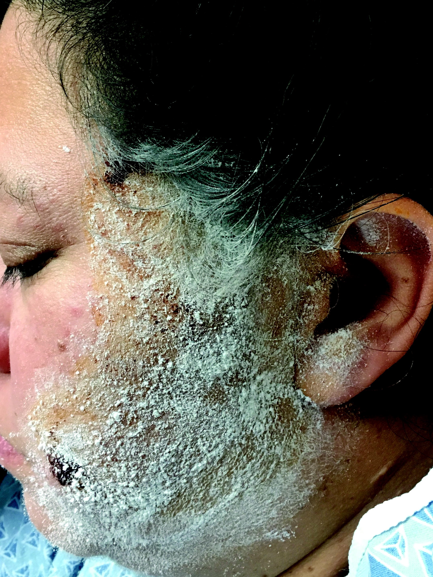
Imaging
Figure 1
Figure 2
Shcherbina A, et al.
© 2019 American Academy of Neurology
Notes:
Figure 1: Minor test, before treatment.
Figure 2: Repeat Minor test, after treatment (both images were obtained after the patient
chewed gum for 1 minute).

Slide 4
Frey’s syndrome
Gustatory sweating is caused by abnormal innervation of facial sweat glands by the sprouting parasympathetic fibers following an injury to auriculotemporal nerve¹.
The distribution can be very patchy, making the Minor test essential to accurately target the involved area.
Shcherbina A, et al.
© 2019 American Academy of Neurology
Notes:
References
1. Jansen S, Jerowski M, Ludwig L, Fischer-Krall E, Beutner D, Grosheva M. Botulinum
toxin therapy in Frey's syndrome: a retrospective study of 440 treatments in 100
patients. Clin Otolaryngol. 2017 Apr; 42(2):295-300.

