Slide 1
Teaching NeuroImages
AN 8 YEAR OLD FEMALE WITH DIPLOPLIA
Neurology
Resident & Fellow Section
Copyright © 2019 American Academy of Neurology

Slide 2
VIGNETTE
8-year-old female presented with 1-month history of diplopia and right abducens nerve palsy.
Non-contributory past medical history
Copyright © 2019 American Academy of Neurology
Lu et al.

Slide 3
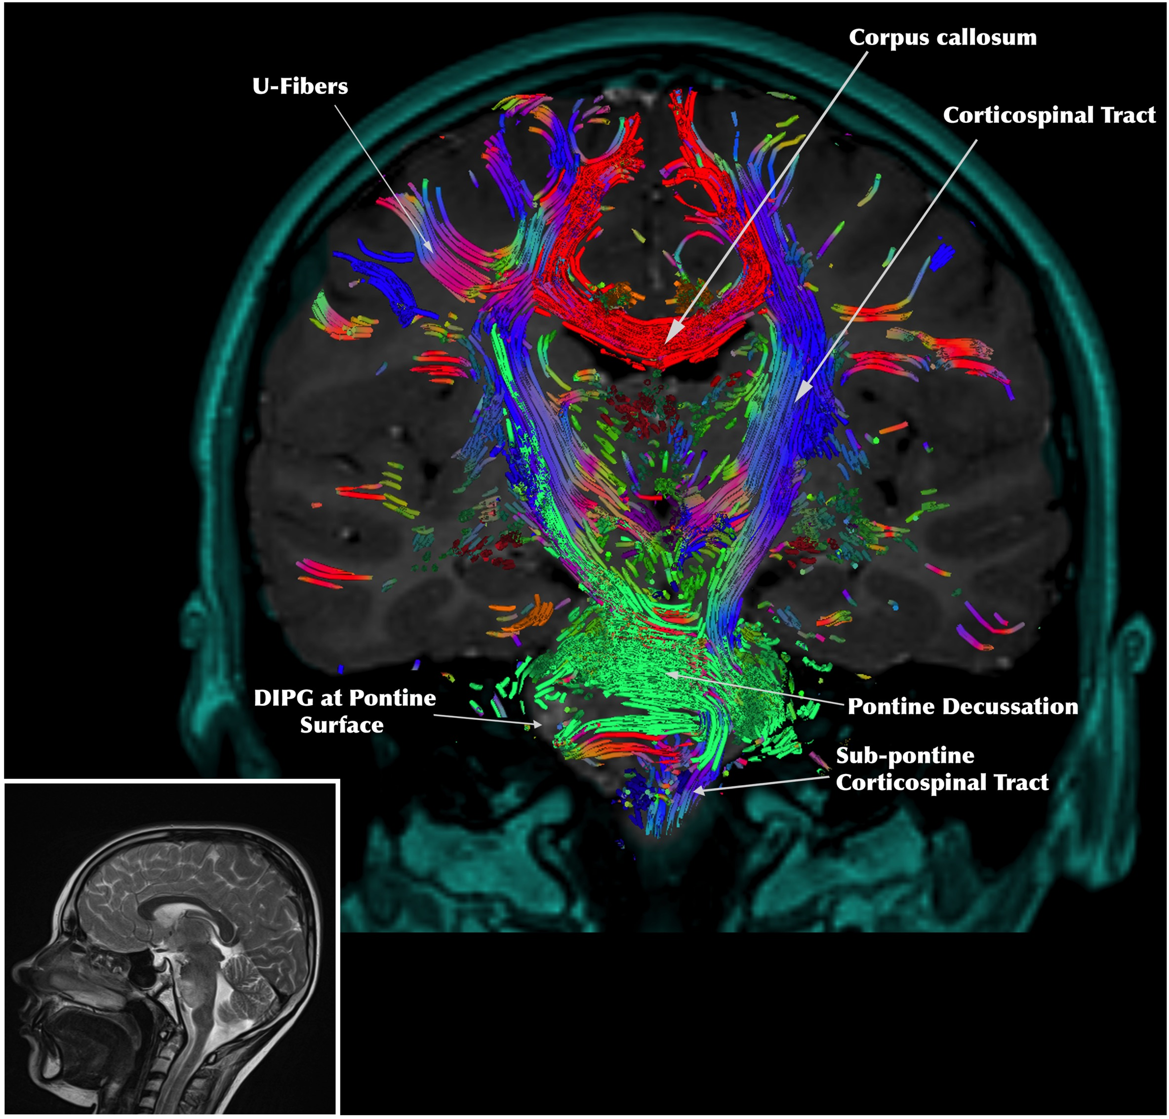
IMAGE
Copyright © 2019 American Academy of Neurology
Lu et al.
Notes:
Coronal T1 gadolinium-enhanced magnetic resonance imaging (MRI) of DIPG patient with overlaid tractography, with sagittal T2 MRI provided for references. This image was generated by Synaptive™ Modus Plan software featuring BrightMatter AutoSeg (Synaptive Medical Inc., Toronto, Canada).

Slide 4
Diagnosis/Conclusions
DIFFUSE INTRINSIC PONTINE GLIOMA (DIPG)
Typical presentation history of DIPG.
Reconstruction shows at the level of the pontine decussation a right-sided disruption of the pontocerebellar fibers anterior to the descending corticospinal fibers involving the pontine nuclei region.
Other critical structures such as corpus callosum and cortical U-fibers visualized in greater detail.
Understanding how white matter tract anatomy relates to DIPG lesions may allow us to further understand how best to safely approach surgical biopsy to improve diagnosis and molecular profiling while limiting the risk of functional deficit. This requires validation in the future.
Copyright © 2019 American Academy of Neurology
Lu et al.

