Slide 1
Disorder of sweat, tonic pupil and areflexia
Teaching NeuroImages Neurology Resident and Fellow Section
© 2020 American Academy of Neurology

Slide 2
Vignette
A 40-year-old man presented with 10-year-history of excessive sweating on the right side, progressing to absence of sweat, rough skin, heat intolerance and blurred vision.
Examination showed anhidrosis (right side), diffuse areflexia and Adie tonic pupils. Starch iodine test showed absence of sweating (Figure). Pupillary reflex was poor (Video). Skin biopsy was unremarkable. Ross syndrome was diagnosed.
© 2017 American Academy of Neurology
Franco IA , et al.

Slide 3
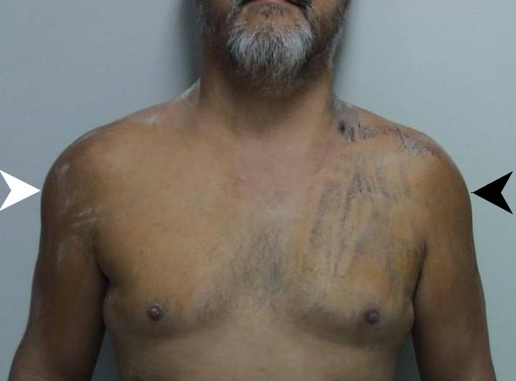
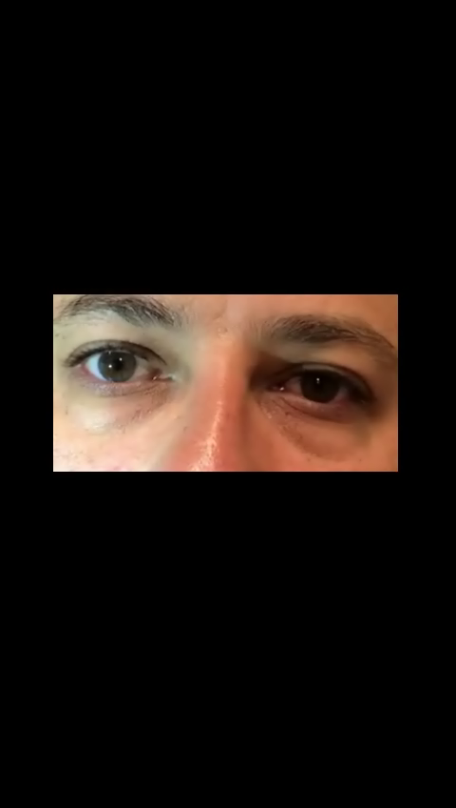
Figure
Video
© 2017 American Academy of Neurology
Franco IA , et al.
Notes:
Legend of the figure: The chest and shoulders were covered with a 0.02% alcoholic solution of iodine and with rice starch powder, which changes from white to black in the presence of sweat (black arrow). The iodine test showed absence of sweating over the anterior part of right side (white arrow).
Legend of the video: Bilateral tonic pupils observed in the patient with Ross syndrome. Note the absence of bilateral pupillary contraction in the presence of light stimulation.

Slide 4
Disorder of sweat, tonic pupil and areflexia: the Ross syndrome
Ross syndrome is an autonomic disorder characterized by impairment of sweat, tonic pupil and areflexia¹.
The disease has a progressive cutaneous sensory and autonomic involvement, with impairment in heat production¹.
Pathophysiological mechanisms include damage in peripheral autonomic system and dorsal root ganglia ².
© 2020 American Academy of Neurology
Franco IA , et al.
Notes:
Slow EJ, Lang AE. Oculogyric Crises: A Review of Phenomenology, Etiology, Pathogenesis, and Treatment 2017;32:2:193-202.
2. Grotzsch H, Sztajzel R, Burkhard PR. Levodopa-induced ocular dyskinesia in Parkinson’s disease 2007;14:1124-1128.

