Slide 1
A 66-year-old woman with ptosis and diplopia
Teaching NeuroImages
Neurology
Resident and Fellow Section
© 2017 American Academy of Neurology

Slide 2
Vignette
66-year-old woman
Presented with unilateral ptosis and diplopia for 2 weeks
Ptosis, and limited adduction, elevation and depression in the left eye
Pupils were isocoric and reactive in both eyes
Yang KH, et al

Slide 3
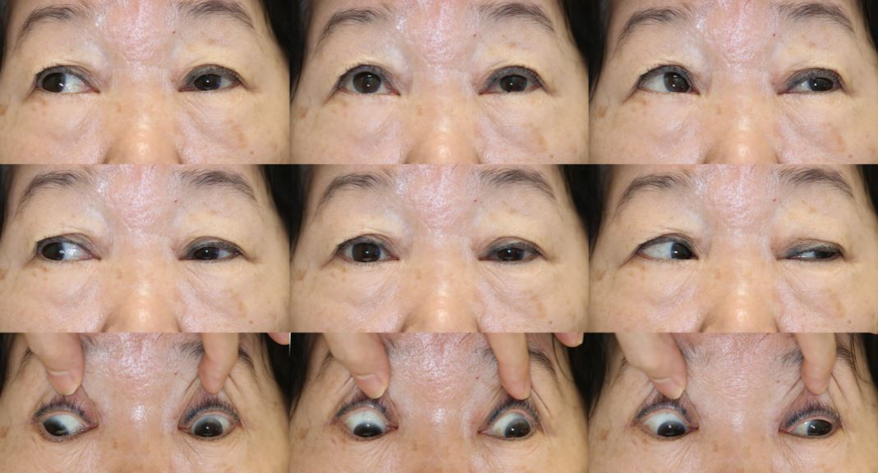
Extraocular motility
Yang KH, et al
Notes:
Figure 1. She showed ptosis, and limited adduction, elevation and depression in the left eye.

Slide 4
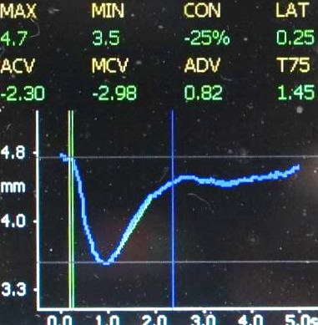
Imaging
Yang KH, et al
Notes:
Figure 2. (Left) Pupillography of the left eye showing normal pupillary light response in a patient with left oculomotor nerve palsy.
(Middle) Transfemoral left internal carotid angiography revealed a 5mm-sized elongated aneurysm with inferior projection (arrows) at the posterior communicating artery origin. (Right) Contrast-enhanced thin-section T1-weighted coronal image showed the aneurysm (short arrows) compressing the left oculomotor nerve at the cavernous sinus. The right oculomotor nerve traversing in the cavernous sinus was normally well identified as a round low signal (long arrow).

Slide 5
A 66-year-old woman with ptosis and diplopia
“Rule of the pupil”: Oculomotor nerve palsy sparing the pupil are rarely aneurysms, while that involving the pupil are often aneurysms.
This case violates the rule of the pupil, proven with pupillography.
Yang KH, et al
Notes:
1. Trobe JD. Third nerve palsy and the pupil. Footnotes to the rule. Arch Ophthalmol 1988;106(5):601-2. PubMed PMID: 3358724.
Kim HM,
2. Yang HK, Hwang JM. Quantitative analysis of pupillometry in isolated third nerve palsy. PLoS One 2018;13(11):e0208259. PMID: 30496292.

