Slide 1
A 3-day-old newborn with intractable seizures
Teaching NeuroImages
Neurology
Resident and Fellow Section
© 2020 American Academy of Neurology

Slide 2
Vignette
A term baby, with uncomplicated pregnancy and delivery, developed intractable multifocal seizures on his third day of life.
EEG showed frequent multifocal electrographic and electroclinical seizures.
MRI with MR spectroscopy of the brain was performed (Figure).
Scramstad et al.
© 2020 American Academy of Neurology

Slide 3
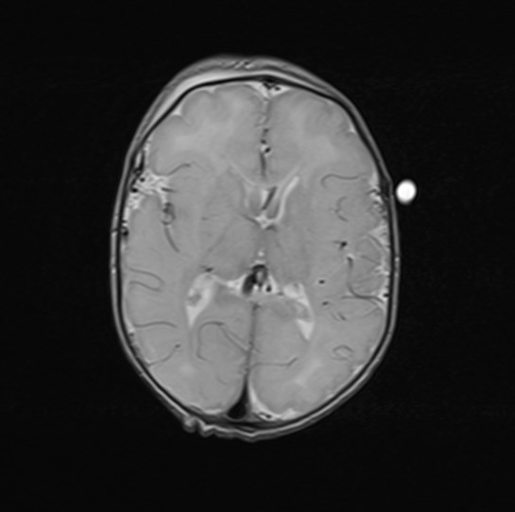
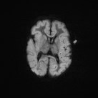
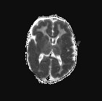
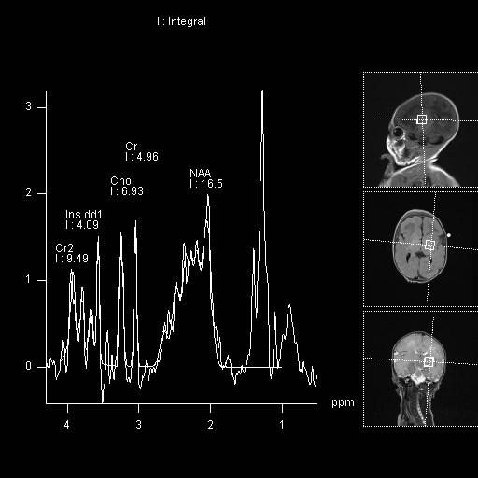
Imaging
A
B
C
D
Scramstad et al.
© 2020 American Academy of Neurology
Notes:
Figure 1. MR images and MR spectroscopy in a 4-day-old term infant
Axial T2 shows cortical swelling with decreased grey-white differentiation (b) Axial DWI shows abnormal increased signal in the cortex, basal ganglia, thalami and corpus callosum with (c) associated decreased signal on ADC (d) MR spectroscopy, obtained over the left basal ganglia, demonstrates an elevated lactate peak.

Slide 4
EARLY IMAGING OF SULFITE OXIDASE DEFICIENCY MIMICS SEVERE HYPOXIC ISCHEMIC ENCEPHALOPATHY
Metabolic testing revealed elevated urine sulfocysteine, reduced plasma cysteine and homocysteine and normal uric acid.
Cerebrospinal fluid lactate was elevated.
The diagnosis was consistent with isolated sulfite oxidase deficiency, confirmed on genetic testing.
This is an autosomal recessive inherited inborn error of metabolism without treatment.
Early in the course, similar to molybdenum cofactor deficiency, this disorder may mimic profound hypoxic ischemic encephalopathy.
Scramstad et al.
© 2020 American Academy of Neurology
Notes:
References
1. Claerhout H, Witters P, Regal L et al. Isolated sulfite oxidase deficiency. J Inherit Metab Dis Epub 2017 Oct 4.
2. Relinque B, Bardallo L, Granero M, Jimenez PJ, Luna S. Isolated sulfite oxidase deficiency. J Neonatal Perinatal Med Epub 2015 Mar 10.

