Slide 1
Teaching NeuroImages
A 53-year-old man with recurrent stroke
Neurology®
Resident & Fellow Section
© 2020 American Academy of Neurology

Slide 2
Vignette
A 56-yr-old hypertensive male.
presented with left-sided weakness of 2-h duration.
Past history of right hemiparesis due to left parietal infarct.
Examination showed dysarthria and left hemiparesis (NIHSS 8/42).
Y. Muralidhar Reddy et al.
© 2020 American Academy of Neurology

Slide 3
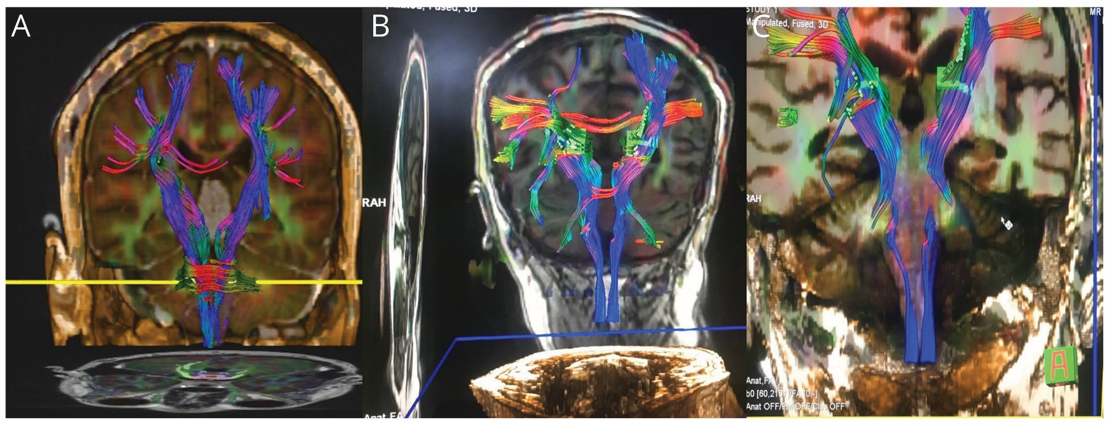
Image
Figure 1
Figure 2
Y. Muralidhar Reddy et al.
© 2020 American Academy of Neurology
Notes:
Figure 1. MR Axial images showing diffusion restriction and corresponding ADC reversal suggestive of acute infarct in left inferior parietal lobe (A-B); FLAIR showing gliotic scar in left parietal lobe (C); angiogram showing left M2 stenosis (D).
Figure 2. DTI images showing normal decussation of pyramidal tracts in caudal medulla in normal subjects (A); no decussation in the given case (B-C).

Slide 4
All hemiparesis are not contralateral
Present stroke deficit is due to ipsilateral hemiparesis
Ipsilateral hemiparesis is mostly seen with posterior fossa malformations and remote infarctions¹
It results from injury to uncrossed corticospinal tract (CST) in patients of remote brain injury or with no decussation of CST or injury to ipsilateral extrapyramidal motor pathway.²
Y. Muralidhar Reddy et al.
© 2020 American Academy of Neurology
Notes:
References
1. Saada F, Antonios N. Existence of ipsilateral hemiparesis in ischemic and hemorrhagic stroke: two case reports and review of the literature. Eur Neurol.2014; 71(1-2):25-31.
2. Inatomi Y, Nakajima M, Yonehara T, Ando Y. Ipsilateral hemiparesis in ischemic stroke patients. Acta Neurol Scand. 2017 Jul;136(1):31-40

