Slide 1
Teaching NeuroImages
A 34-year-old woman with cognitive dysfunction
Neurology®
Resident & Fellow Section
© 2020 American Academy of Neurology

Slide 2
Vignette
A 34-year-old woman with no pre-morbid diseases
She presented with history of progressive apathy, executive dysfunction and memory impairment of 1 year duration
Examination revealed moderate frontal dysfunction and bipyramidal signs
Rudrabhatla et al.
© 2020 American Academy of Neurology

Slide 3
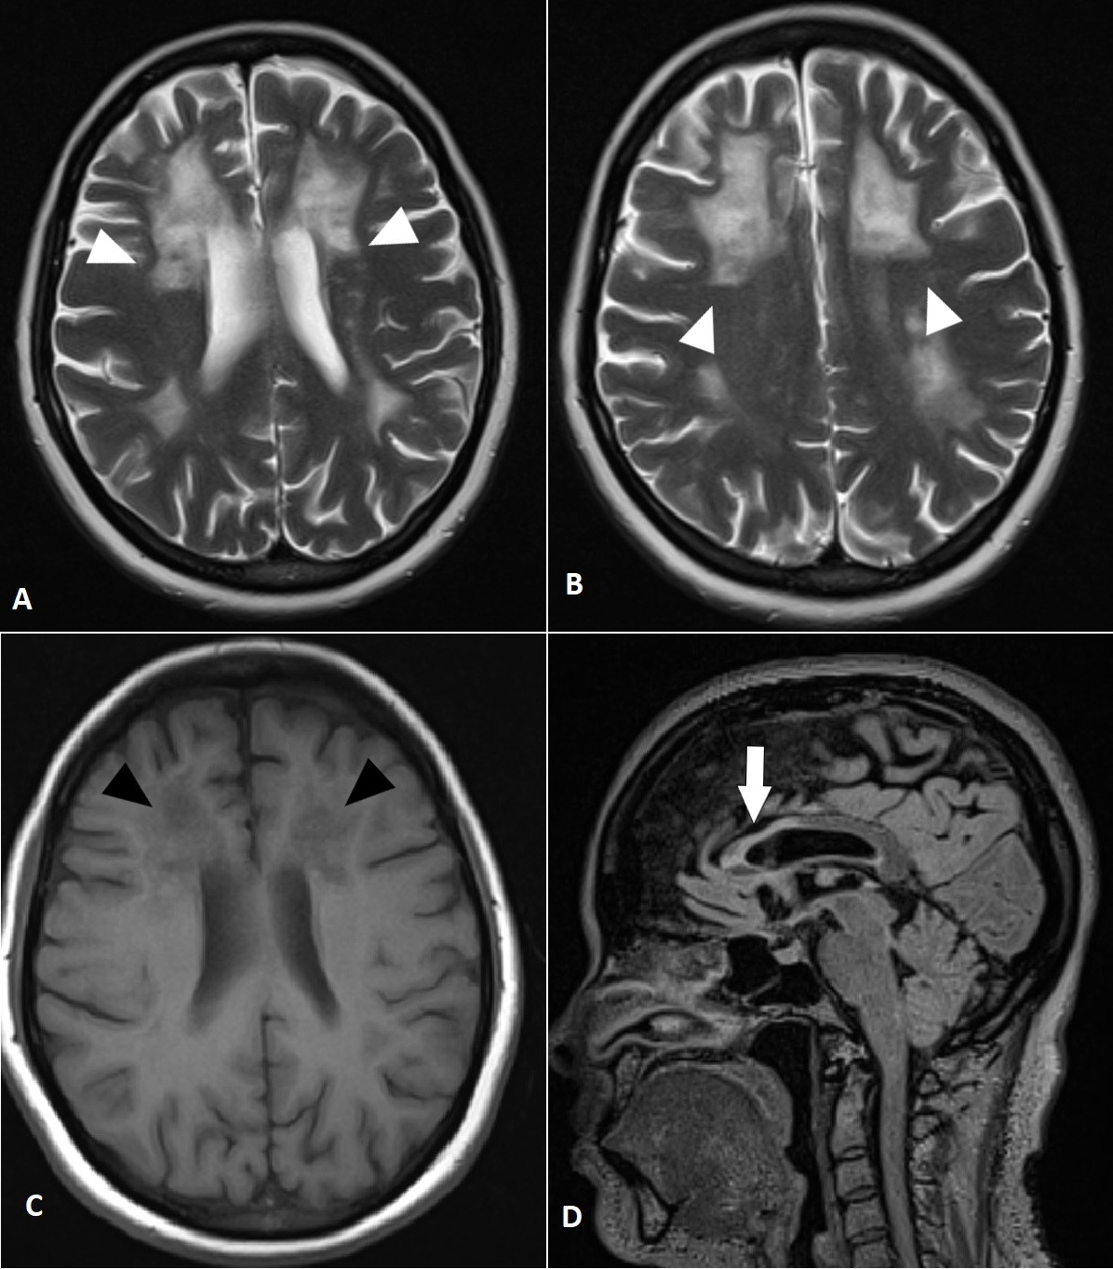
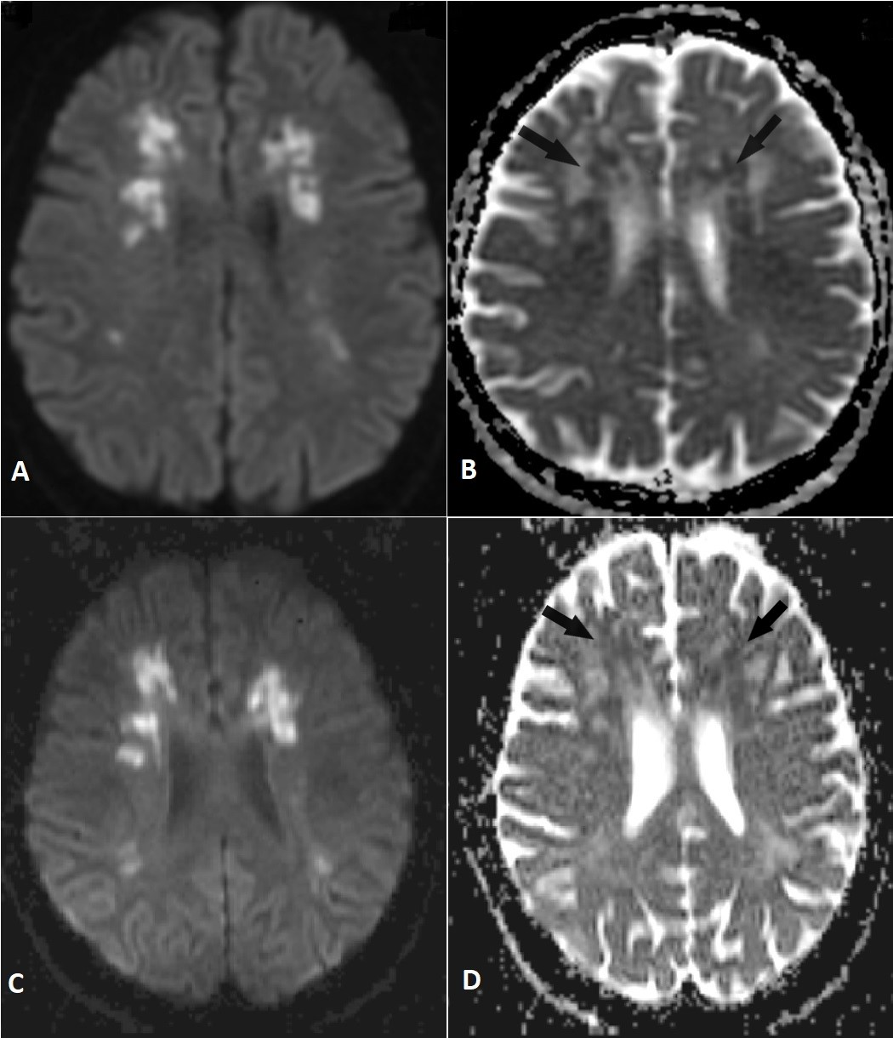
Neuroimaging
Rudrabhatla et al.
© 2020 American Academy of Neurology
Notes:
Figure 1: Core features in T2-FLAIR and T1 MRI sequences
Axial T2-weighted images (A,B) show confluent symmetrical frontal-predominant white matter hyperintensities sparing subcortical U-fibers (white arrow-heads), hypointense in T1-weighted sequences (C, black arrow-heads); Sagittal T2-FLAIR (D) shows corpus callosum hyperintensities and atrophy (arrow).
Figure 2: Persistent abnormalities in MRI diffusion sequences
DWI images (A,B) show deep white matter diffusion restriction with corresponding low ADC (black arrows), persistent in similar sequences taken 4 months later (C,D).

Slide 4
Adult-onset leukoencephalopathy with axonal spheroids and pigmented glia (ALSP)
The presence of symmetric (or asymmetric) non-enhancing white matter lesions with persistent diffusion restriction and corpus callosum thinning favors the diagnosis of ALSP over acquired demyelination
Inheritance is autosomal dominant or sporadic
Next generation sequencing showed a pathogenic heterozygous missense mutation in exon 18 of CSF1R gene (p.Ile794Thr) confirming this diagnosis
Rudrabhatla et al.
© 2020 American Academy of Neurology
Notes:
References
Adams SJ, Kirk A, Auer RN. Adult-onset leukoencephalopathy with axonal spheroids and pigmented glia (ALSP): Integrating the literature on hereditary diffuse leukoencephalopathy with spheroids (HDLS) and pigmentary orthochromatic leukodystrophy (POLD). J Clin Neurosci. 2018;48:42–9.
Konno T, Yoshida K, Mizuno T, Kawarai T, Tada M, Nozaki H, et al. Clinical and genetic characterization of adult-onset leukoencephalopathy with axonal spheroids and pigmented glia associated with CSF1R mutation. Eur J Neurol. 2017;24(1):37-45.

