Slide 1
Teaching NeuroImages
A 10-year old female with unilateral
vision loss
Neurology®
Resident & Fellow Section
© 2020 American Academy of Neurology

Slide 2
Vignette
A 10-year-old female child presented with right eye diminished vision for 6 months along with headache and intermittent vomiting for 3 weeks.
Oral steroids improved headache and vomiting, but not vision.
Samanta et al.
© 2020 American Academy of Neurology

Slide 3
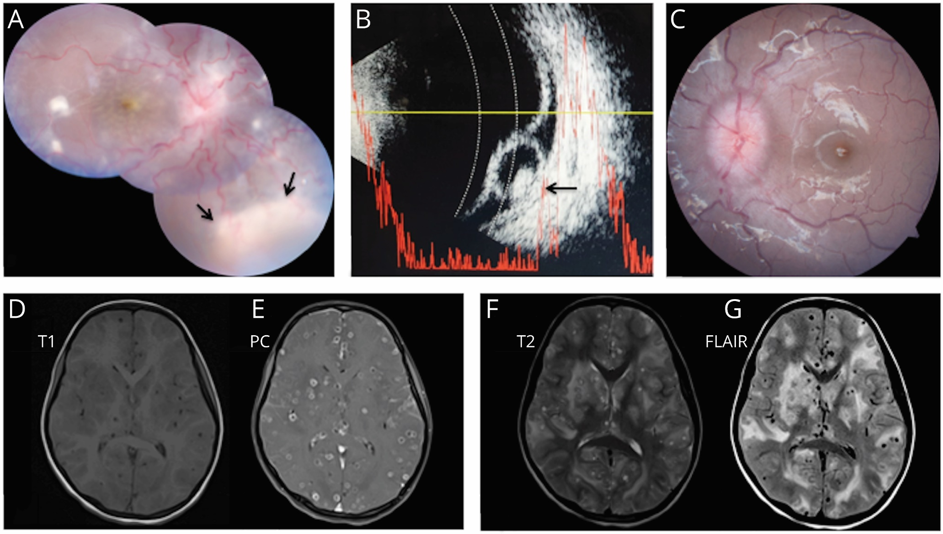
Image
Samanta et al.
© 2020 American Academy of Neurology
Notes:
Figure 1: Fundus photograph of right eye (a) shows disc edema, vascular tortuosity, vitritis, neurosensory detachment and whitish subretinal lesion infero-nasally (black arrow); Ocular ultrasound (b) shows hyporeflective lesion with internal hyperreflectivity (scolex; black arrow) suggestive of subretinal cysticercosis; left eye (c) shows disc edema with normal posterior pole. Brain MRI shows multiple parenchymal neurocysticercosis in various stages on T1-weighted (d) and T2-weighted (f) images, gadolinium-enhancement of multiple cyst walls (e) and significant pericystic edema on fluid attenuated inversion recovery sequence (g).

Slide 4
Neurocysticercosis with unilateral vision loss
Brain MRI findings of enhancing cystic lesions lacking a visible scolex along with clinical features of intracranial hypertension including headache and vomiting suggested diagnosis of Multiple neurocysticercosis (MNCC).¹
Unilateral vision loss with panuveitis in MNCC may result from concurrent subretinal cysticercosis.²
Samanta et al.
© 2020 American Academy of Neurology
Notes:
References
1. Del Brutto OH, Nash TE, White Jr AC, Rajshekhar V, Wilkins PP, Singh G, et al. Revised diagnostic criteria for neurocysticercosis. Journal of the neurological sciences. 2017;372:202-10.
2. Ganesh SK, Priyanka. Analysis of clinical profile, investigation, and management of ocular cysticercosis seen at a tertiary referral centre. Ocular Immunology and Inflammation. 2018; 26(4): 550-7.

