Slide 1

Teaching NeuroImages
When the Arm Inspires
Neurology®
Resident & Fellow Section
© 2020 American Academy of Neurology

Slide 2
Vignette
A 6 month old presented with left arm weakness dating from birth consistent with brachial plexopathy.
  She had significant elbow flexion and shoulder abduction weakness and mild finger, wrist, and arm extension weakness.
Electrodiagnostic findings demonstrated panplexus injury.
  Median, lateral antebrachial cutaneous, and radial sensory responses were abnormal
  EMG showed evidence of reinnervation in C5-T1 innervated muscles with ongoing denervation in C5-6 innervated muscles.
  Spontaneous deltoid firing coincident with inspiration was observed on EMG (video 1).
McKinney et al.
© 2020 American Academy of Neurology

Slide 3
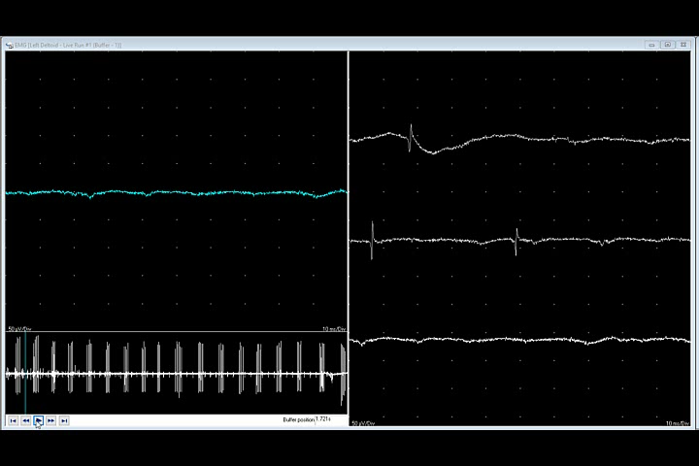
Video
McKinney et al.
© 2020 American Academy of Neurology
Notes:
Video 1.
Concentric needle electrode EMG recording from the deltoid muscle showing spontaneous, rhythmic firing of motor unit potentials time locked with inspiration (based on visual inspection) starting at the 0.01 second mark. Intermittent fibrillation potentials are also present. Recording gain is 50 µV/Div with a sweep of 10 ms/Div.

Slide 4
Breathing Arm
This phenomenon can occur in obstetrical and non-obstetrical plexopathies when the C5 nerve root is injured proximal to the phrenic nerve origin.
Chaotic regrowth of axons results in atypical innervation patterns.
In “breathing arm”, aberrant regeneration of fibers originally supplying the phrenic nerve supply upper trunk muscles resulting in synkinesis with contraction of upper trunk muscles with inspiration.
An alternative explanation is that this represents a compensatory response to diaphragmatic inadequacy. However, aberrant reinnervation is favored when there is no clinical evidence of respiratory insufficiency.
Respiratory synkinesis is significant when considering surgery as it is indicative of severe proximal root or trunk injury. ¹⁻²
McKinney et al.
© 2020 American Academy of Neurology
Notes:
References
1. Swift TR. The breathing arm. Muscle Nerve. 1994 Jan;17(1):125-9.
2. Friedenberg SM, Hermann RC. The breathing hand: obstetric brachial plexopathy reinnervation from thoracic roots? J Neurol Neurosurg Psychiatry 2004;75:158–160.

