Slide 1
Teaching NeuroImages
Neurology®
Resident & Fellow Section
© 2021 American Academy of Neurology

Slide 2
Vignette
Subacute onset of Horizontal diplopia due to abducens nerve palsy and Ipsilateral excessive tearing.
No other medical history reported
Palaiodimou et al.
© 2021 American Academy of Neurology

Slide 3
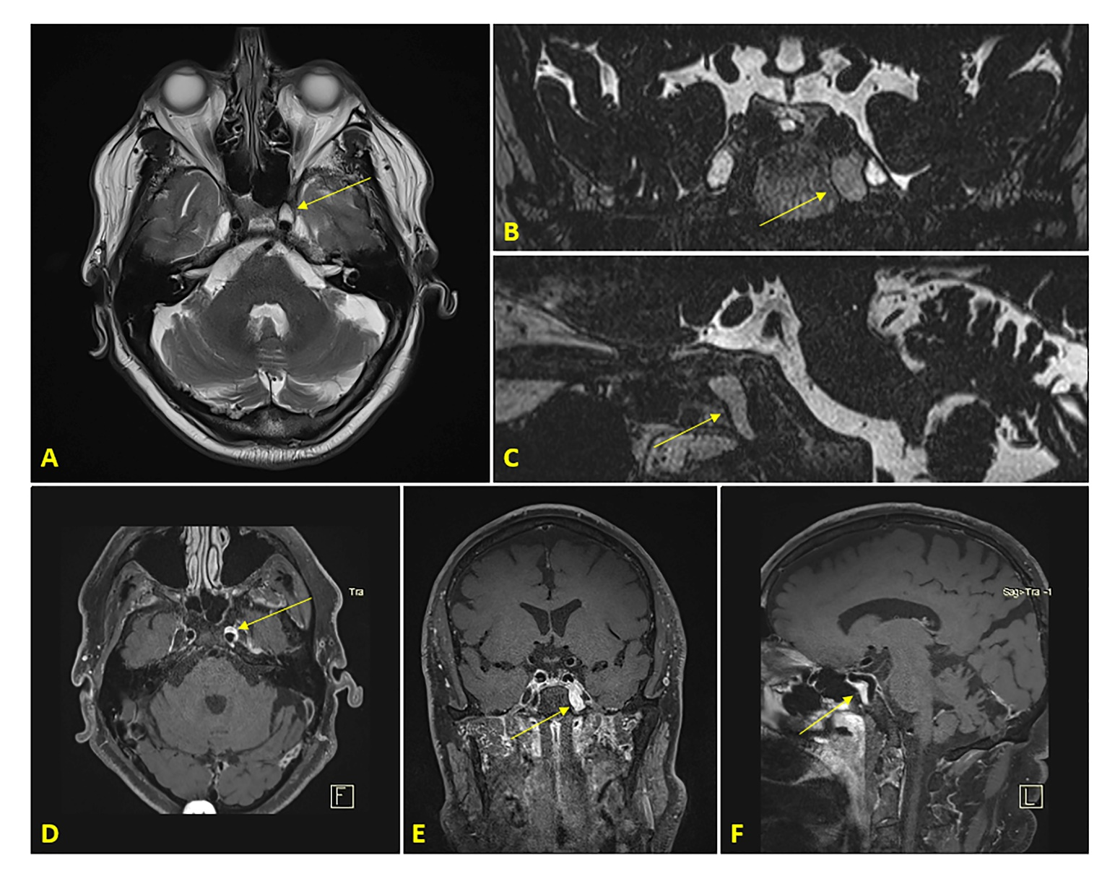
Image
Palaiodimou et al.
© 2021 American Academy of Neurology
Notes:
Figure 1. Neuroimaging findings of a patient with an internal carotid sympathetic plexus schwannoma
Axial brain MRI with T2-weighted sequence showing a hyperintense lesion along the anterior wall of the left internal carotid artery at the transition of the petrous to cavernous segment (Panel A, arrow). Coronal (Panel B) and sagittal (Panel C) brain MRI with T2-weighted 3D turbo spin-echo (SPACE) sequence with multi-planar reconstruction demonstrating the elongated course of the lesion (arrows) within the left carotid canal, juxta-positionally to the internal carotid artery from the lower part of the cavernous segment until the mid part of the petrous segment. Axial (Panel D), coronal (Panel E) and sagittal (Panel F) brain MRI with T1-weighted 3D SPACE black blood sequence showing the homogeneously enhancing lesion (arrows) in the left carotid canal, surrounding the petrous and cavernous segments of the internal carotid artery.

Slide 4
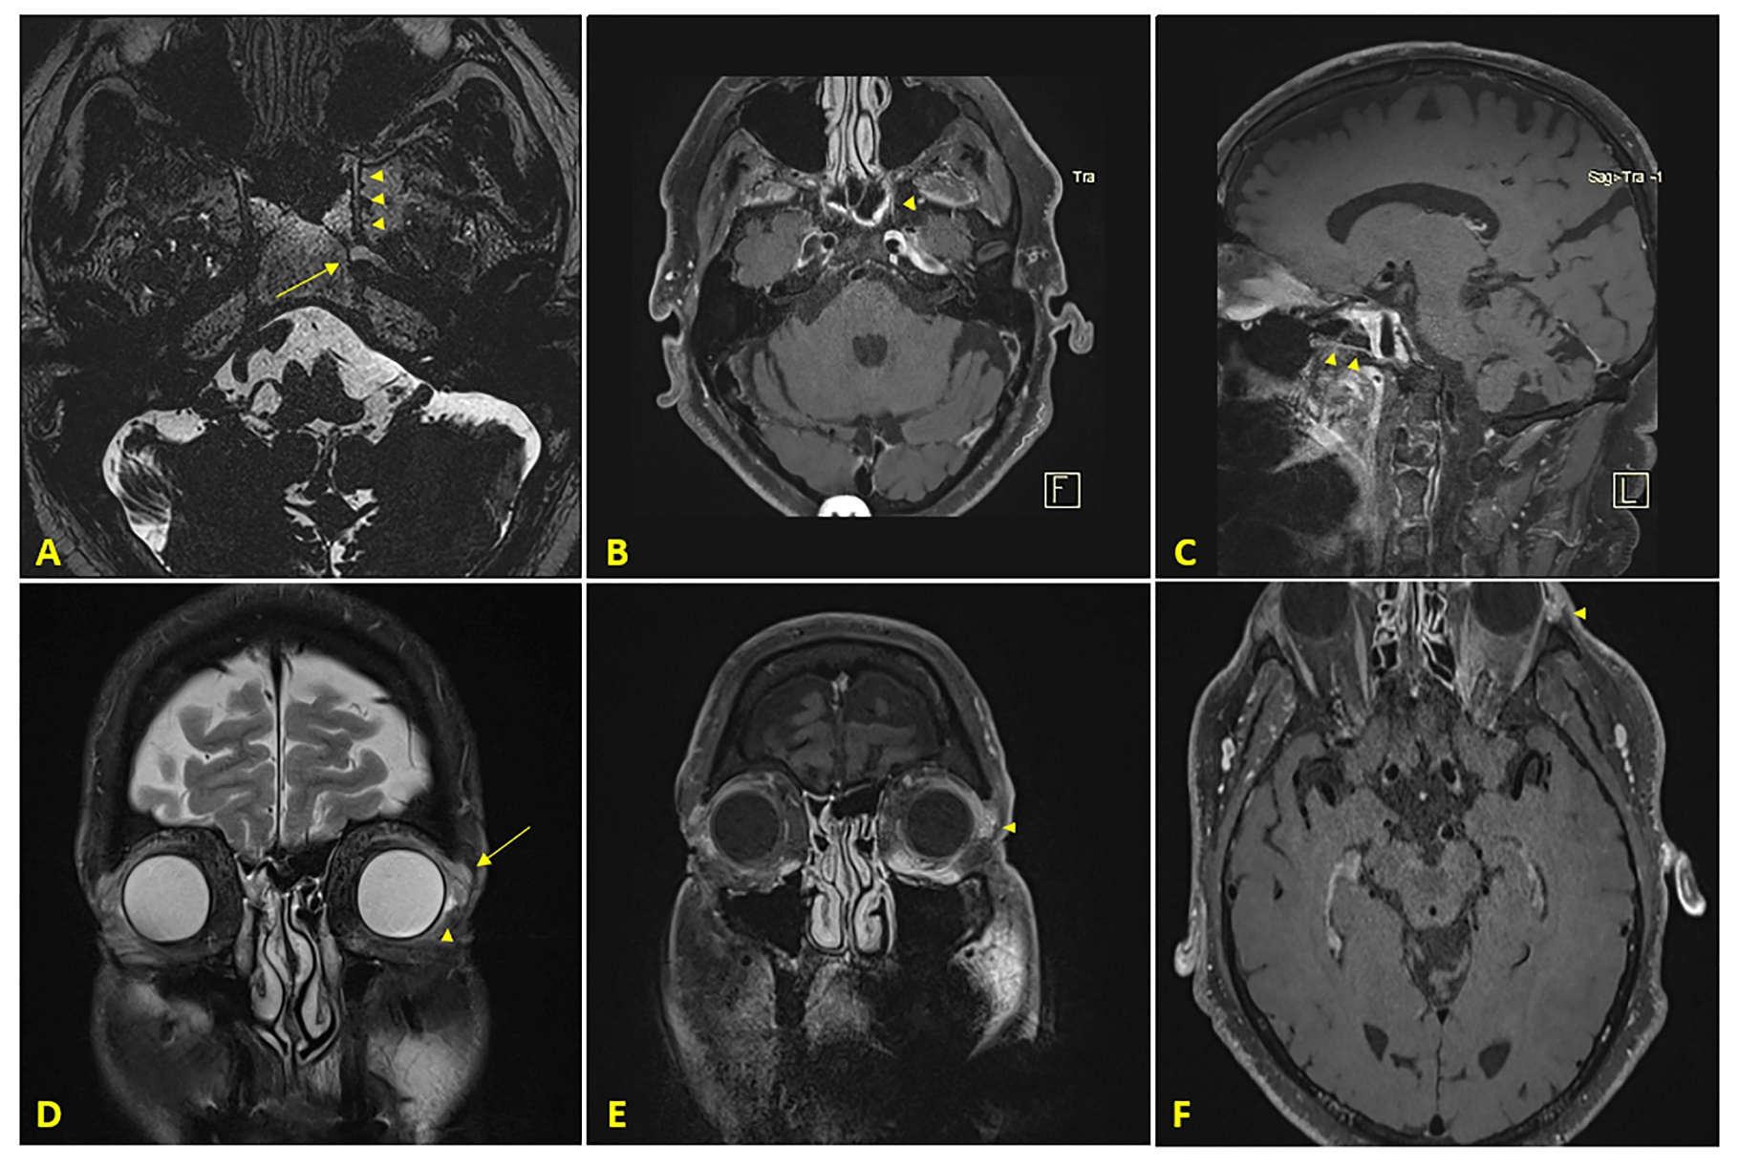
Image
Palaiodimou et al.
© 2021 American Academy of Neurology
Notes:
Figure 2. Neuroimaging findings of a patient with excessive tearing attributed to an internal carotid sympathetic plexus schwannoma
Axial brain MRI with T2-weighted 3D turbo spin-echo (SPACE) sequence with multi-planar reconstruction showing the vidian nerve (Panel A, arrowheads) within the pterygoid canal in close proximity to the internal carotid sympathetic plexus schwannoma (Panel A, arrow). Axial (Panel B) and sagittal (Panel C) brain MRI with T1-weighted 3D SPACE black blood sequence demonstrating the left vidian canal as an enhancing linear structure (arrowheads) at the level of the petrous segment of the internal carotid artery. Coronal brain MRI with T2-weighted sequence with fat saturation showing an edematous, enlarged left lacrimal gland (Panel D, arrow) compared to the healthy side and fluid accumulation in the left excretory lacrimal ducts (Panel D, arrowhead). Coronal (Panel E) and axial (Panel F) brain MRI with T1-weighted 3D SPACE black blood sequence confirming the enlargement of the left lacrimal gland with more intense contrast enhancement (arrowheads) compared to the healthy side.

Slide 5
Abducens Nerve Palsy With Ipsilateral Excessive Eye Tearing Attributed to an Internal Carotid Artery Sympathetic Plexus Schwannoma
The neuroimaging findings were characteristic for an internal-carotid artery sympathetic plexus (ICSP) schwannoma compressing the left abducens nerve, leading to horizontal diplopia.
Subsequent irritation of the deep petrosal nerve originating directly from ICSP and continuing as the vidian nerve may have led to the lacrimal gland edema and excessive left-eye tearing.
Palaiodimou et al.
© 2021 American Academy of Neurology
Notes:
References
1. Hamilton JD, Demonte F, Ginsberg LE. Imaging of carotid canal sympathetic plexus schwannoma. AJNR Am J Neuroradiol. 2011;32(7):1212-5.
2. Tόre U, Seker A, Kurtkaya O, Pamir MN. Internal carotid plexus schwannoma of the cavernous sinus: case report. Neurosurgery. 2003;52(2):435-8.

