Slide 1
Teaching NeuroImages
A 9-Year-Old Boy With Epilepsy, Intellectual Disability, and Behavioral Issues
Neurology
Resident & Fellow Section
© 2021 American Academy of Neurology

Slide 2
Vignette
We report a 9-year-old boy with a history of Angelman syndrome (AS) with associated epilepsy, behavioral issues, intellectual disability, and sleep disturbance.
Genetic testing revealed a methylation imprinting defect, thereby confirming the diagnosis of AS.
His seizures were well controlled on monotherapy with clobazam and he underwent a routine EEG (figure), which showed a notched delta pattern.
Nascimento et al.
© 2021 American Academy of Neurology

Slide 3
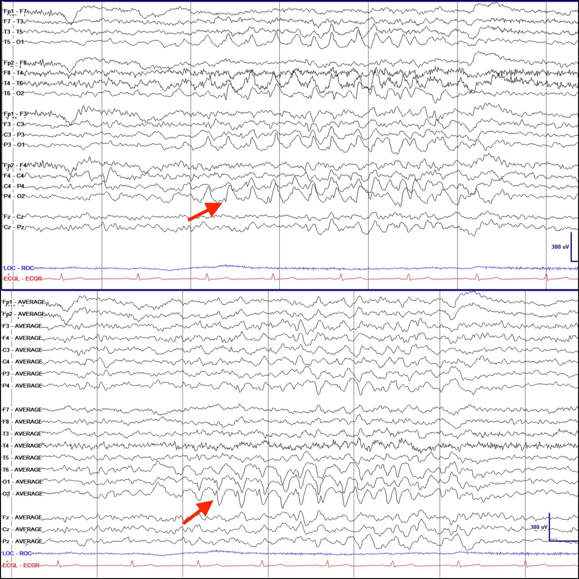
Figure
Nascimento et al.
© 2021 American Academy of Neurology
Notes:
Figure. Routine EEG shows notched delta pattern [sensitivity 20 uV/mm, LF 1 Hz, HFF 70 Hz, notch on/60 Hz, timebase 30 mm/sec].
EEG: bipolar (upper panel) and referential/average (lower panel) show bilateral occipital, right more than left, delta waves (200-250 uV, 4 Hz) superimposed with spikes (arrows) consistent with notched delta.

Slide 4
Notched Delta and Angelman Syndrome
Notched delta pattern, one of the characteristic EEG findings in AS, is characterized by delta waves intermixed with spikes or sharp waves giving it a “notched” appearance.
In the context of a suggestive phenotype, this EEG pattern should raise suspicion for AS.
Clinicians should be reminded, nonetheless, that notched delta can be seen in other conditions such as Rett syndrome and different chromosomal abnormalities including 4p(-) syndrome.
Lastly, patients with AS may have other patterns on EEG such as persistent rhythmic high-voltage 4-6 Hz activity. ^{1, 2, 3}
Nascimento et al.
© 2021 American Academy of Neurology
Notes:
References
1. Korff CM, Kelley KR, Nordli Jr DR. Notched delta, phenotype, and Angelman syndrome. J Clin Neurophysiol. 2005;22(4):238-243.
2. Thibert RL, Larson AM, Hsieh DT, Raby AR, Thiele EA. Neurologic manifestations of Angelman syndrome. Pediatr Neurol. 2013;48(4):271-279.
3. Vendrame M, Loddenkemper T, Zarowski M, et al. Analysis of EEG patterns and genotypes in patients with Angelman syndrome. Epilepsy Behav. 2012 Mar;23(3):261-265.

