Slide 1
A 79-year-old woman exhibited vertigo, dysarthria, inability to stand, painful paresthesia, and disorientation.
Teaching NeuroImages
Neurology
Resident & Fellow Section
© 2019 American Academy of Neurology

Slide 2
Vignette
A 79-year-old woman developed infectious periaortitis after an abdominal aortic aneurysm repair
A month later, she exhibited vertigo, dysarthria, and unsteady gait, progressing to inability to stand, painful paresthesia, and disorientation.
Her examination showed dysmetria, dysdiadochokinesia, and severe cerebellar ataxia.
© 2019 American Academy of Neurology
Terán et al.

Slide 3
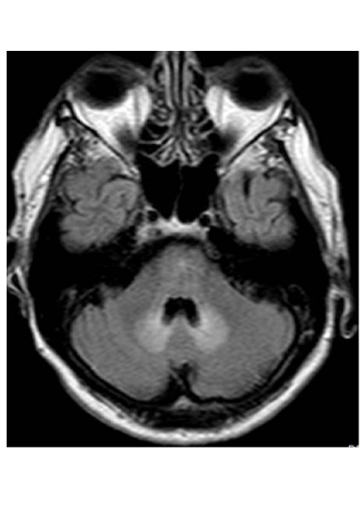
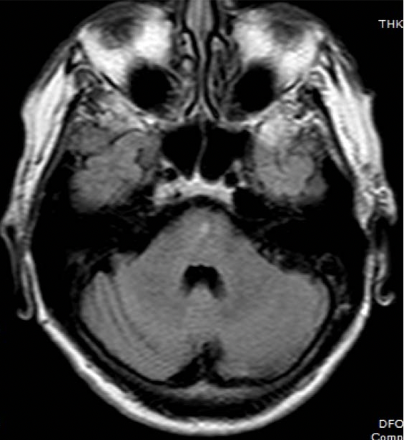
Imaging
Terán et al.
© 2019 American Academy of Neurology
Notes:
Figure. Hyperintense dentate nucleus on brain MRI.
FLAIR sequences one month after initiation of metronidazole (A) showed bilateral symmetrical hyperintensities in the dentate nucleus. Within 15 days after metronidazole discontinuation (B), the signal in the dentate had normalized.

Slide 4
The dentate sign in subacute cerebellar ataxia: metronidazole neurotoxicity
The cerebellar syndrome, and the abnormal dentate signal, resolved within 15 days after discontinuation of metronidazole.
Besides encephalopathy and polyneuropathy, metronidazole can induce subacute cerebellar ataxia by selectively affecting the dentate nucleus.
Recognizing this imaging hallmark identifies a reversible iatrogenic complication and prevents unnecessary testing.
© 2019 American Academy of Neurology
Terán et al.
Notes:
References
1. Woodruff BK, Wijdicks EF, Marshall WF. Reversible metronidazole-induced lesions of the cerebellar dentate nuclei. N Engl J Med 2002;346:68-69.
2. Higashi M, Irioka T, Matsumoto T, Mizusawa H. Metronidazole-induced encephalopathy. Intern Med 2013;52:843-844.

