Slide 1
Resident & Fellow Section Teaching NeuroImage Arm and Leg Ballismus and Oral-buccal Dyskinesia
Tencer et al.

Slide 2
Vignette
18-year-old male with Type 1 Diabetes
Presents with acute onset bilateral arm and leg ballismus and oral-buccal dyskinesia
Labs were notable for glucose 394 and HgbA1c >14.
Tencer et al.

Slide 3
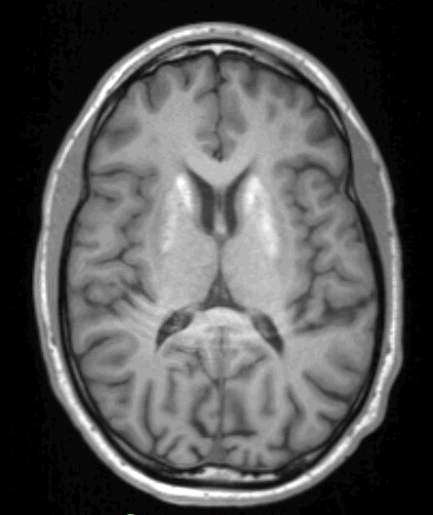
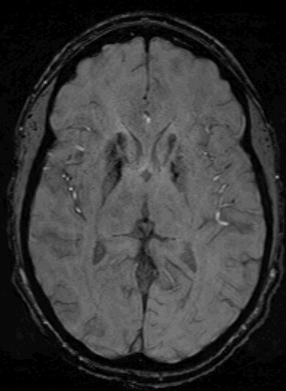
Imaging
Tencer et al.
Notes:
(A) Axial T1-weighted MRI showing hyperintensity in the caudate and putamen
(B) Axial Susceptibility Weighted Imaging showing abnormal signal in the corresponding region possibly reflecting microhemorrhages

Slide 4
Basal Ganglia T1 Hyperintensity and SWI Signal Diabetic Striatopathy in an 18-Year-Old Man With Type 1 Diabetes Mellitus
Symptoms resolved over 48 hours with glucose control.
Diabetic Striatopathy is most often described in older individuals with Type 2 diabetes.
Movement disorder often resolves with glycemic control however many patients require pharmacologic treatments.
Deep brain stimulation was reported beneficial in cases with disabling involuntary movements.
Hemorrhage is thought to be probable pathogenesis, possibly from hyperglycemia induced vasculopathy
Tencer et al.
Notes:
References
1. Chua CB, Sun CK, Hsu CW, Tai YC, Liang CY, Tsai IT. "Diabetic striatopathy": clinical presentations, controversy, pathogenesis, treatments, and outcomes. Sci Rep. 2020;10(1):1594.
2. Cherian A, Thomas B, Baheti NN, Chemmanam T, Kesavadas C. Concepts and controversies in nonketotic hyperglycemia-induced hemichorea: further evidence from susceptibility-weighted MR imaging. J Magn Reson Imaging. 2009;29(3):699-703.

