Slide 1
Resident & Fellow Section Teaching An 18 yo with headache and vision loss
Lineback CM, et al.

Slide 2
Vignette
18-year-old man with spastic quadriparesis from a traumatic C6 spinal cord injury (SCI) presented with recurrent episodes of thunderclap headache and blurry vision. He recently noticed episodes of urinary incontinence between scheduled self-catheterizations that were associated with headaches. His medications included muscle relaxants and oral anticoagulation for a history of deep vein thrombosis.
On presentation, he experienced a sudden severe holocephalic headache, described as “two butcher knives stabbing”, and abrupt loss of vision. His blood pressure rose to 200s/90s (baseline 90s/60s) mmHg; pulse was 48 beats/min. His visual symptoms resolved within an hour, followed by two recurrent episodes over the following 24-hours.
Examination revealed inability to count fingers in all four visual quadrants and chronic quadriparesis. CT angiography showed multifocal narrowing of the cerebral arteries. Transcranial Doppler (TCD) showed elevated mean flow velocities consistent with vasospasm.
He was diagnosed with autonomic dysreflexia (AD) secondary to neurogenic bladder. A foley catheter was placed, and episodes ceased. Repeat TCDs demonstrated resolution of vasospasm. He was discharged home with suprapubic catheter, with baseline blood pressure and normal vision.
Lineback CM et al.

Slide 3
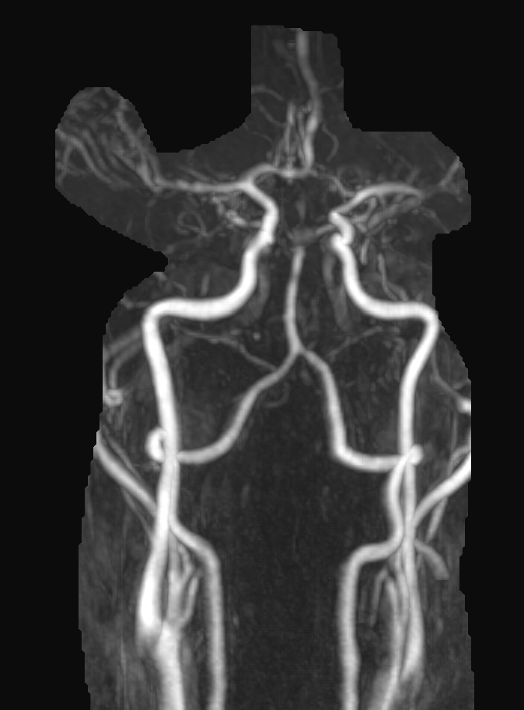
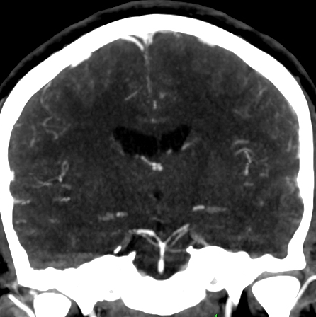
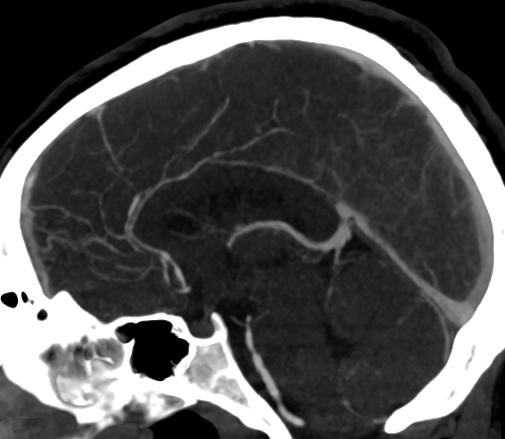
Imaging Figure 1
B
A
B
D
C
D
Lineback CM et al.
Notes:
Figure 1. CT angiography brain imaging displays diffuse arterial narrowing of cerebral vasculature, consistent with RCVA.
Spinal hardware placed after traumatic diving accident. There is an anterior cervical fusion from C4 to C7 as well as posterior spinal fusion hardware extending from C4 to the upper thoracic spine.
Three-dimensional reconstruction of the patient's anterior and posterior circulation; narrowing of the distal basilar artery can be appreciated.
Mid-sagittal view of patient's CTA completed upon clinical worsening of acute headache and vision loss, illustrating diffuse vasospasm of both posterior and anterior vascular distributions. Arrows show focal vasospasm – the proximal basilar artery, the distal basilar artery; proximal anterior cerebral artery focal narrowing, and multi-focal vasospasm of a frontopolar branch off the anterior cerebral artery.
Coronal section at the level of the basilar artery completed at the same time as sagittal imaging to the left display multifocal vasospasm of the posterior circulation. Arrows re-demonstrate a distal narrowing of the basilar artery, just proximal to the superior cerebral artery. Additional arrows show proximal vasospasm of the left posterior cerebral artery and of the proximal and distal right posterior cerebral artery.

Slide 4
Imaging Figure 2
B
A
B
D
C
D
Lineback CM et al.
Notes:
Figure 2.
Axial MRI brain images illustrating evolution of the patient's clinical course, consistent with acute infarcts.
Top panels were obtained upon admission (A & B) while bottom panels (C & D) were completed upon clinical deterioration as represented by acute worsening of headache and vision loss.
(A) Diffusion weighted imaging raising concern for acute infarct (red arrow) of the left parieto-occipital lobe.
(B) Apparent diffusion coefficient imaging correlating with image at left, confirming acute infarct (red arrow) of the left parieto-occipital lobe.
(C) Repeat imaging completed upon clinical worsening as described above showing progression of diffusion weight imaging hyperintensities; red arrows display bilateral occipital lobe diffusion restriction.
(D) Red arrows display apparent diffusion coefficient correlates for the image at left, confirming acute bilateral infarcts of the occipital lobes.

Slide 5
An 18 year-old with headache and vision loss
RCVS is characterized by thunderclap headaches, with or without focal neurological symptoms, and is associated with segmental constriction of cerebral arteries that resolves within 3 months. Symptoms are often preceded by stressors, including medications, post-partum state, or, as we hypothesize in this case, autonomic dysreflexia (AD).
Injury at or above the sixth thoracic (T6) spinal cord segment segregates spinal sympathetic preganglionic neurons from supraspinal modulation and can result in AD, clinically defined as episodic hypertension and baroreflex-mediated bradycardia initiated by unrestrained sympathetic reflexes in the decentralized cord.
AD is often triggered by noxious yet unperceived stimuli below the injury level, resulting in sudden sympathetic overactivity, due to interruption of the descending modulatory pathway which normally inhibit the sympathetic neurons in response to hypertension.
AD can persist until the trigger is removed (e.g. foley catheter to decompress bladder)
Severe headaches or other neurological symptoms in patients with subacute SCI at T6 or above warrant investigation for RCVS-associated AD. Even after triggers of AD are removed, close neurological monitoring and attention to signs of cerebral hypoperfusion proves necessary to prevent secondary cerebral ischemic injuries.
Lineback CM et al.
Notes:
Include all references if applicable for this Teaching (Video) NeuroImage slide deck

Slide 6
References
1. Calabrese LH, Dodick DW, Schwedt TJ, Singhal AB. Narrative review: reversible cerebral vasoconstriction syndromes. Ann Intern Med. Jan 2007;146(1):34-44. doi:10.7326/0003-4819-146-1-200701020-00007
2. Ducros A. Reversible cerebral vasoconstriction syndrome. Lancet Neurol. Oct 2012;11(10):906-17. doi:10.1016/S1474-4422(12)70135-7

