Slide 1

Resident & Fellow Section
Teaching NeuroImage
A 12 year old male presented with chorea induced by fasting and exercise
Imtiaz et al.

Slide 2
Vignette
A 12 year old male presented for evaluation of chorea induced by fasting and exercise.
Prior EEG, Brain MRI and spectroscopy, metabolic and chromosomal microarray evaluations were unremarkable.
Fasting EEG showed diffuse spike-wave discharges with postprandial normalization (Figure 1).
Genetic testing confirmed pathogenic SLC2A1 gene mutation consistent with Glucose transporter-1 (GLUT-1) deficiency syndrome, which is uniquely responsive to ketogenic diet.
Imtiaz et al.

Slide 3
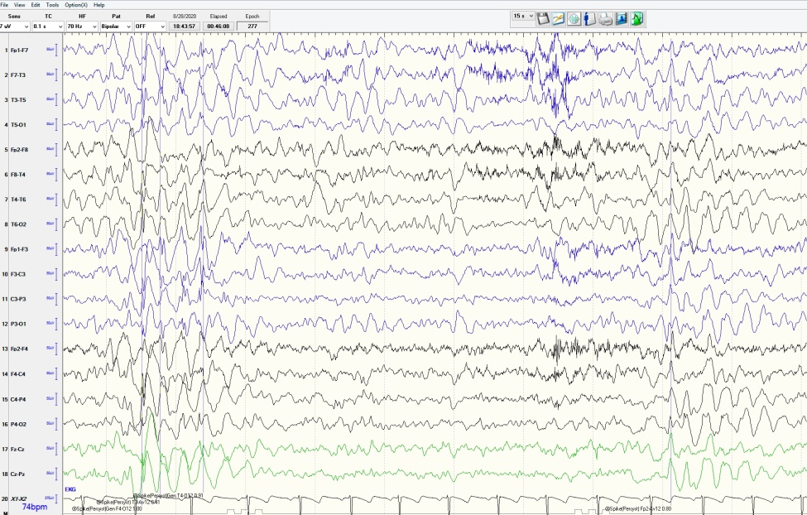
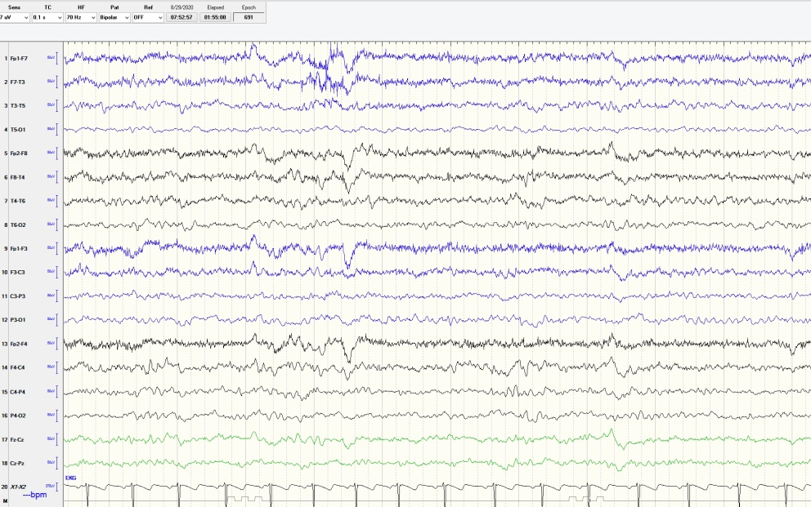
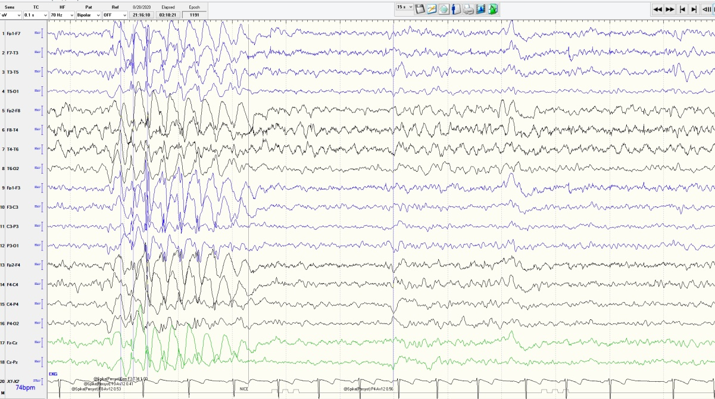
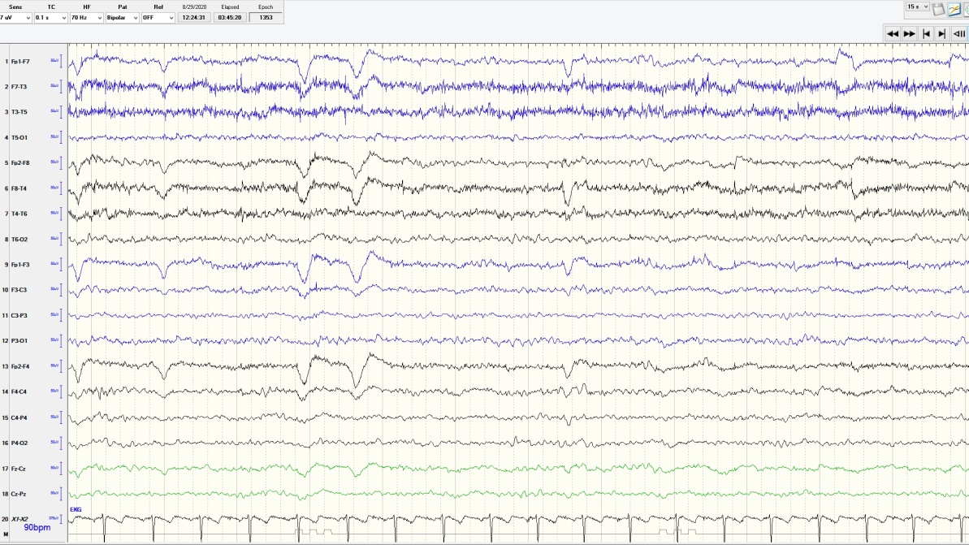

A
C
B
D
Imtiaz et al.
Notes:
Figure 1: EEG during fasting (A, B) showing diffuse, poorly-formed 3-4 Hz spike-wave discharges. EEG after meal (C, D) showing background normalization. This EEG is shown on a 15-second epoch with a sensitivity of 7 μV in a longitudinal bipolar montage, left over right.

Slide 4
“Fasting EEG in GLUT-1 transporter deficiency syndrome”
EEG findings in GLUT-1 deficiency syndrome may include multifocal spikes or generalized 3-4 Hz spike discharges, with potential postprandial improvement (1, 2).
This case highlights the role of pre- and postprandial EEG recording as a supportive test for GLUT-1 deficiency syndrome. Please note, the sensitivity and specificity of this finding is not known, and other testing is required to confirm the diagnosis.
Imtiaz et al.
Notes:
References:
1. Koch, H., Weber, Y. G. The glucose transporter type 1 (Glut1) syndromes. Epilepsy & Behavior 2018; 91:90-93.
2. VonMoers A, Brockman K, Wang D, et al. EEG features of Glut-1 deficiency syndrome. Epilepsia 2002; 43(8): 41-5.

