Slide 1
Examination of a 62-year-old woman with ptosis
Teaching NeuroImages
Neurology
Resident and Fellow Section
© 2020 American Academy of Neurology

Slide 2
Vignette
On examination of a 62-year-old woman with diagnosis of myasthenia gravis, left eyelid manual elevation caused exacerbated ptosis on the right (enhanced ptosis) (Figure and Video).
Carvalho Neto et al.
© 2020 American Academy of Neurology

Slide 3
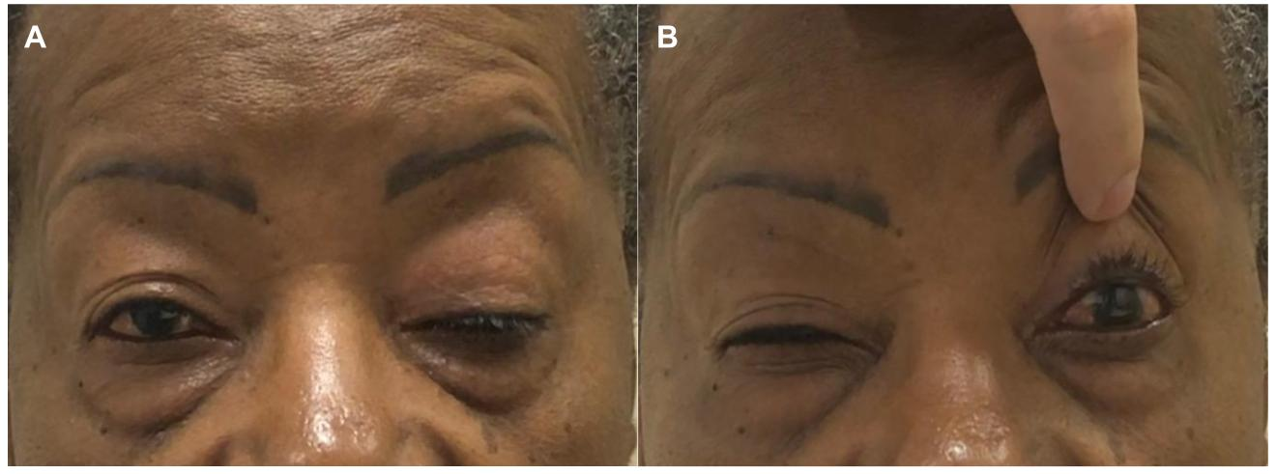
Imaging
Carvalho Neto et al.
© 2020 American Academy of Neurology
Notes:
Complete ptosis of the left eyelid and semi ptosis of the right. Observe the contraction of the frontalis muscles in an attempt to compensate ptosis.
Left eyelid manual elevation caused exacerbated ptosis on the right (enhanced ptosis). Contraction of frontalis muscles still present.

Slide 4
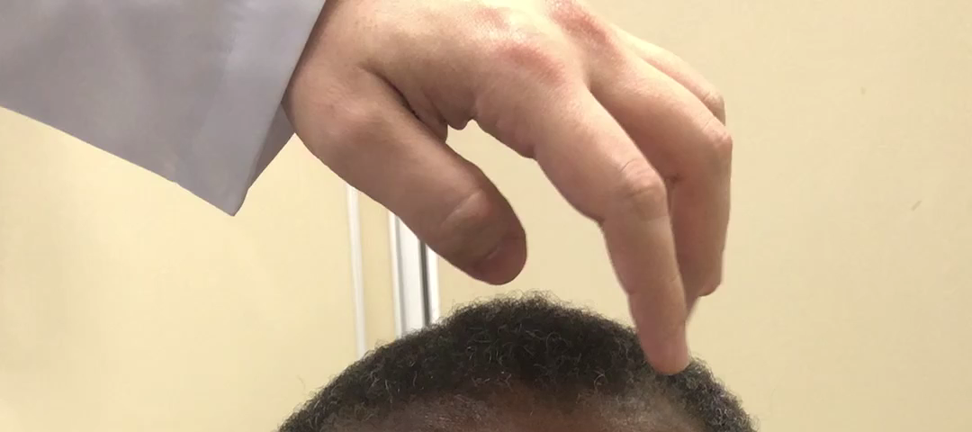
Video
Carvalho Neto et al.
© 2020 American Academy of Neurology
Notes:
Observe the complete ptosis of the left eyelid and semi ptosis of the right. Left eyelid manual elevation caused exacerbated ptosis on the right (enhanced ptosis).

Slide 5
Useful bedside testing for myasthenia gravis: The phenomenon of enhanced ptosis
According to Hering’s law, there is approximately equal innervation of the levator palpebrae superioris muscles in both eyelids.
In an asymmetric ptosis, the motor impulses increase to compensate ptosis on the more affected side but also flow to contralateral eyelid, which mitigate ptosis on this side.
With manual elevation of the more affected eyelid, the need to sustain eyelid elevation is relieved, and there is an attenuation of these motor impulses causing ptosis enhancement of the other eyelid.
Carvalho Neto et al.
© 2020 American Academy of Neurology
Notes:
1. Averbuch-Heller L, Poonyathalang A, von Maydell RD, Remler BF. Hering’s law for eyelids: Still valid. Neurology. Sep 1995, 45 (9) 1781-1783.
2. Kumar S, SHARMA VK. Unmasking Ptosis in Both Eyes. New England Journal of Medicine. July 6, 2017 377 (1).

