Slide 1

Resident & Fellow Section
Teaching NeuroImage
A 52-Year-Old Woman with Diminished Vision
Ying Huang et al.

Slide 2
Vignette
A 52-year-old, HIV-negative female presented with one-year of bilateral painless central vision loss that worsened over three months.
A medical examination revealed Argyll-Robertson pupil (i.e., accommodates but does not react to light).
Single-read next-generation sequencing (NGS) of the cerebrospinal fluid (CSF) identified 89 sequence reads corresponding to treponema.
Elevated CSF protein and pleocytosis.
Negative anti-aquaporin-4 and anti-myelin oligodendrocyte glycoprotein antibody levels.
Retinal nerve fiber layer (RNFL) thinning, and bilateral nerve sheath enhancement.
Received penicillin and oral prednisolone and exhibited vision improvement.
Ying Huang et al.

Slide 3
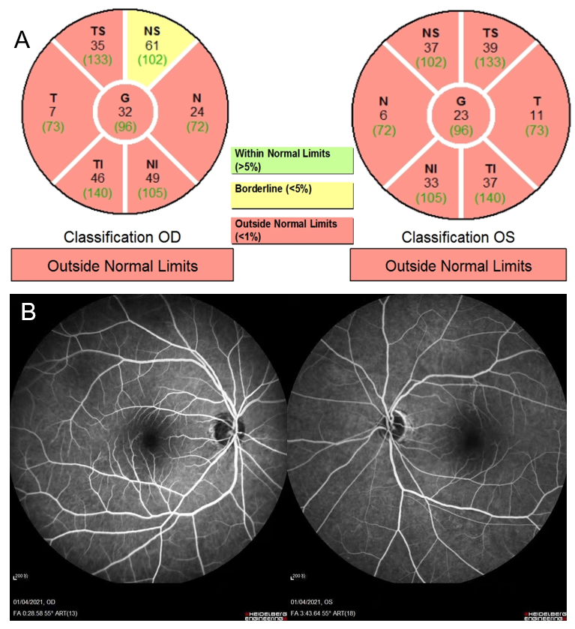
Imaging 1
Ying Huang et al.
Notes:
Figure 1. Ocular Images.
Legend：Optical coherence tomography of the retinal nerve fiber layer (RNFL) revealed bilateral thinning (A). Fundus angiography was unremarkable (B).

Slide 4
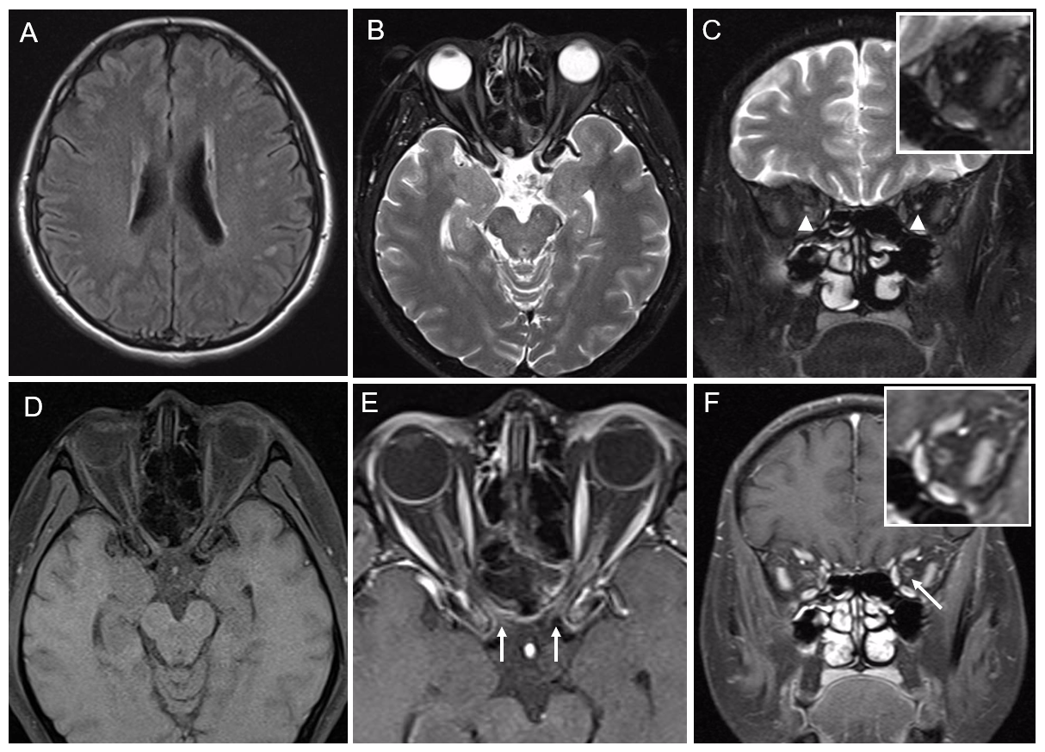
Imaging 2
Ying Huang et al.
Notes:
Figure2. Brain Magnetic Resonance Imaging (MRI) Images.
Legend：FLAIR (A) showed white matter lesions. T2-hyperintense lesions and atrophy in the bilateral optic nerve (arrowhead) were observed (B-C). T1-fat-saturation (D) and T1-gadolinium enhancement (E-F) demonstrated the entire optic nerve sheath (including chiasmal) (arrow).

Slide 5
Table
Table Common pathogens of infectious optic neuropathies
Viral
 | Herpes simplex virus, Epstein-Barr virus, Chikungunya virus, Dengue virus, Influenza Viruses, Mumps virus, Varicella-zoster virus, Cytomegalovirus, Human immunodeficiency virus, Measles virus, Rift valley fever virus, Rubella virus, Zika Virus, West Nile virus
Bacterial
 | Treponema pallidum, Mycobacterium tuberculosis, Bartonella henselae bacteria, Rickettsii, Bacterium Borrelia burgdorferi, Leptospires, Tropheryma whipplei, Mycobacterium leprae, Brucella genus
Fungi
 | Cryptococcus neoformans, Mucorales
Parasites
 | Toxoplasma gondii, Toxocara canis, Toxocara cati, Plasmodium, Nematodes, Onchocerca
Note: All pathogens listed in the table can be detected through next generation sequencing.
Ying Huang et al.
Notes:
Table The common pathogens of infectious optic neuropathies

Slide 6
Rapid Identification of Infectious Optic Neuritis by Next-Generation Sequencing
Infectious causes of optic neuritis are complex.
NGS is an emerging method with the potential to rapidly identify atypical optic neuritis.
Ying Huang et al.
Notes:
1. Eggenberger E R. Infectious Optic Neuropathies. Continuum (Minneap Minn), 2019,25(5):1422-1437.
2. Abel A, Mcclelland C, Lee MS. Critical review: Typical and atypical optic neuritis. Surv Ophthalmol. 2019; 64(6): 770-779.

