Slide 1
Resident & Fellow Section Teaching NeuroImage A 51-year-old man with headache, paresthesia and seizure.
Rosa-Júnior et al.

Slide 2
Vignette
A 51-year-old man
With headache
Legs and arms paresthesia and
Seizure
Rosa-Júnior et al.

Slide 3
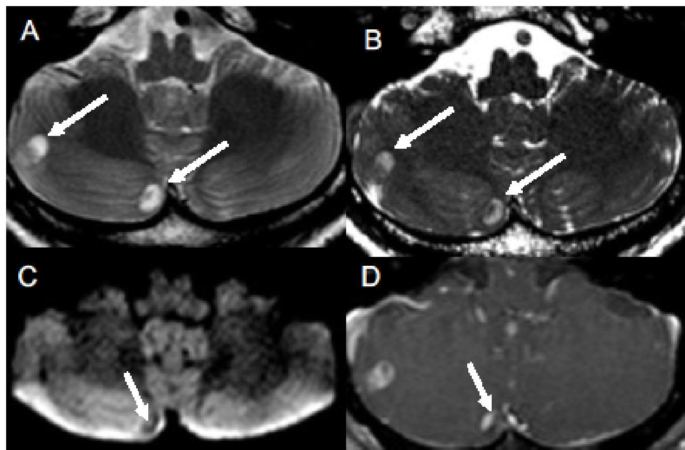
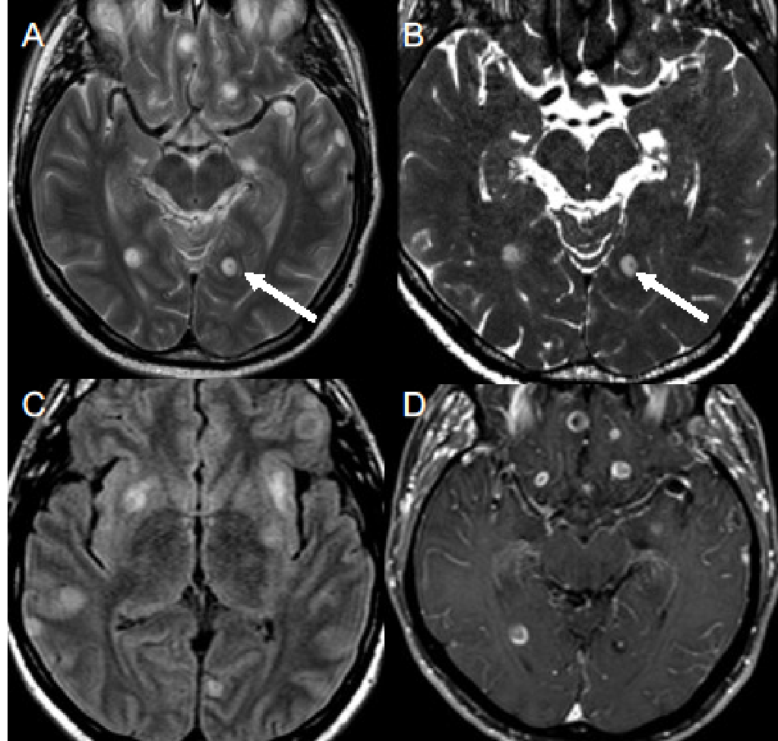
Figure 1 Figure 2
Rosa-Júnior et al.
Notes:
Figure Legends 1:
(A) Axial T2WI shows multiple cystic lesions, one in the left occipital lobe with dot sign (arrows in A and B). Axial FLAIR shows vasogenic edema around most lesions (C). Axial T1WI post gadolinium shows peripheral and dot sign enhancement (D). Dot sign is a nodule within a cystic lesion.
Figure Legends 2:
(A) Axial T2WI shows two cystic lesions in the right cerebellar hemisphere with dot sign (arrows in A and B). Axial DWI shows dot sign (C). Axial T1WI post gadolinium shows nodular and dot sign enhancement (D).

Slide 4
Cryptococcosis in the central nervous system mimicking neurocysticercosis
The dot sign is reported to be pathognomonic of neurocysticercosis.
However other conditions can mimic, including brain tumors and cryptococcosis.
Nevertheless there are imaging differences between neurocysticercosis and cryptococcosis.
In neurocysticercosis usually there is no post-contrast enhancement of the dot sign.
Cryptococcosis encephalitis is a difficult-to-treat disease that can affect immunosuppressed or immunocompetent patients.
Rosa-Júnior et al.
Notes:
1 - Loyse A, Moodley A, Rich P, et al. Neurological, visual, and MRI brain scan findings in 87 South African patients with HIV-associated cryptococcal meningoencephalitis. J Infect 2015;70:668-675. 2 - Chen S, Chen X, Zhang Z, Quan L, Kuang S, Luo X. MRI findings of cerebral cryptococcosis in immunocompetent patients. J Med Imaging Radiat Oncol 2011;55:52-57.

