Slide 1
Teaching NeuroImages
A 17-year-old woman with ataxia, dysarthria, and poor vision
Neurology
Resident & Fellow Section
© 2019 American Academy of Neurology

Slide 2
Vignette
A 17-year-old African Brazilian woman presented with a 1-year history of progressive ataxia, dysarthria and decreased visual acuity. Family history was remarkable for multiple relatives with similar motor symptoms but no visual complaints.
Examination showed upward gaze palsy, dysarthria, ataxia and increased tone and reflexes. Fundoscopic examination and subsequent optic coherence tomography (OTC) revealed bilateral atrophic maculopathy (figure).
Genetic testing confirmed the diagnosis of spinocerebellar ataxia type 3 (SCA3) by revealing abnormal CAG repeats in the ATXN3 gene – the pathologic allele had 68 repeats and the normal allele 14 repeats.
Nascimento et al.
© 2019 American Academy of Neurology

Slide 3
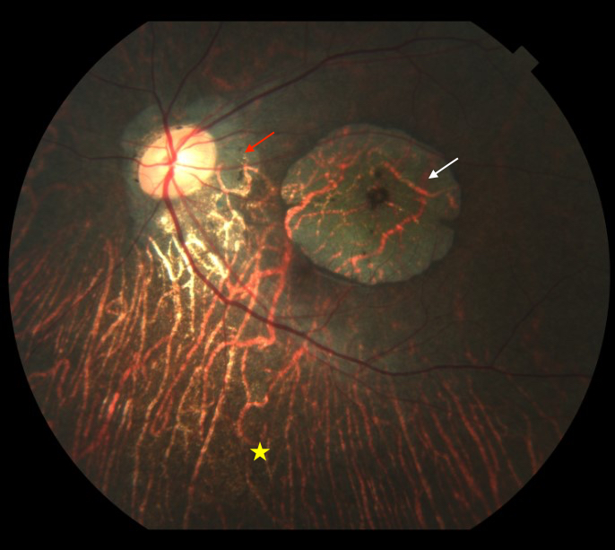
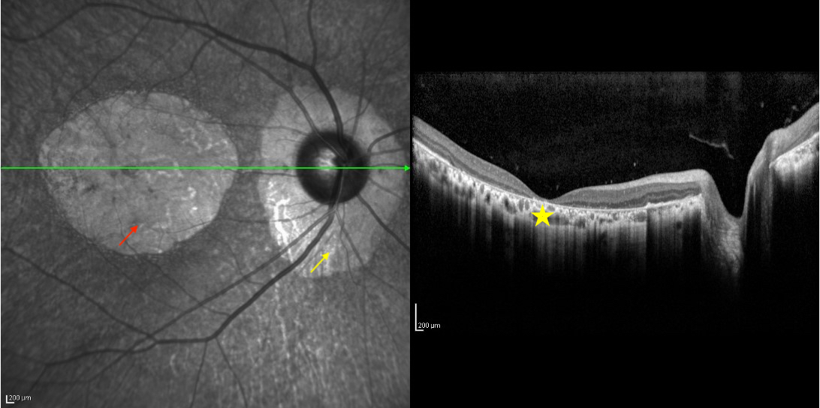
Image
A
B
C
Nascimento et al.
© 2019 American Academy of Neurology
Notes:
Figure – Retinography, left eye (A): this image shows peripapillary chorioretinal atrophy (red arrow), macular atrophy (white arrow) and extensive loss of retinal pigment epithelium in the lower retinal periphery (star). Optical coherence tomography (OCT), right eye (B and C): near-infrared light (B) shows macular atrophy (red arrow) and peripapillary chorioretinal atrophy (yellow arrow); image C shows complete foveal atrophy, loss of deep macular layers within the atrophic topography, and loss of peripapillary retinal pigment epithelium (star).

Slide 4
Retinopathy in spinocerebellar ataxia type 3
Retinopathy, a typical finding in spinocerebellar atrophy type 7, has rarely been associated with SCA3. Further studies should elucidate this association thereby possibly expanding the phenotypic spectrum of SCA3.
Nascimento et al.
© 2019 American Academy of Neurology
Notes:
References
[1] Teive HAG, Ashizawa T. Primary and secondary ataxias. Curr Opin Neurol. 2015;28(4):413-422.
[2] Isashiki Y, Kii Y, Ohba N, Nakagawa M. Retinopathy associated with Machado-Joseph disease (spinocerebellar ataxia 3) with CAG trinucleotide repeat expansion. Am J Ophthalmol. 2001;131(6):808-810.
[3] Durr A, Stevanin G, Cancel G, et al. Spinocerebellar ataxia 3 and Machado-Joseph disease: clinical, molecular, and neuropathological features. Ann Neurol. 1996;39(4):490-499.
[4] Alvarez G, Rey A, Sanchez-Dalmau FB, et al. Optical coherence tomography findings in spinocerebellar ataxia-3. Eye (Lond). 2013;27(12):1376-1381.

