Slide 1
Resident & Fellow Section Teaching NeuroImage A 20-year-old man with bilateral lower limb weakness
Jianyong Li et al.

Slide 2
Vignette
A 20-year-old man with a history of B-cell ALL in remission reported a 2-week history of bilateral lower limb weakness.
Electrophysiological examination showed prolonged latency of F-wave of bilateral tibial nerves.
The CSF opening pressure was increased (>30 cm/H20), with elevated protein level (1683mg/L, RI 150-400mg/L), decreased glucose concentration (5.94mg/dL, RI 50.4-80.64mg/dL) and pleocytosis (854/mm3, RI<10/mm3) in CSF.
Flow cytometry assays for detecting minimal residual disease in CSF disclosed numerous lymphoblasts (CD45+, CD19+, CD34+, CD10+, CD38±, CD20-).
Jianyong Li et al.

Slide 3
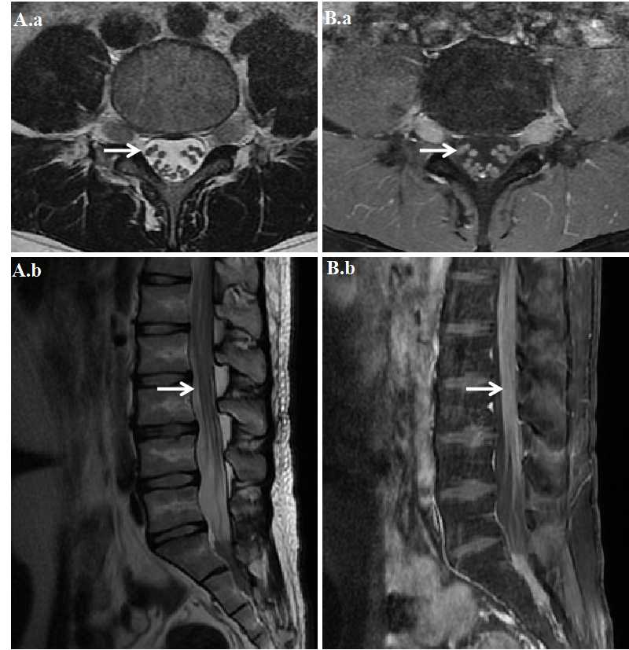
Imaging
T2-weighted axial (A.a) and sagittal (A.b) ,and T1-weighted, post-contrast axial (B.a) and sagittal (B.b) lumbosacral MRI .
Jianyong Li et al.
Notes:
Add figure legend here

Slide 4
Thickened and enhanced cauda equina as a manifestation of acute lymphoblastic leukemia relapse
lumbosacral MRI showed thickened and homogeneously enhanced cauda equina.
Cauda equina involvement as a manifestation of ALL relapse is rare, and lumbosacral MRI markedly improved diagnosis.
Jianyong Li et al.
Notes:
Include all references if applicable for this Teaching (Video) NeuroImage slide deck

