Slide 1

Resident & Fellow Section
Teaching NeuroImage
A 48-year-old woman with small fiber neuropathy
Lucas Piedrafita Vico et al.

Slide 2
Vignette
Patient with clinical signs and symptoms of small fiber neuropathy
Quantitative Sensory Testing with abnormal thermal thresholds
Underwent the Water Immersion Wrinkling Test
Lucas Piedrafita Vico et al.

Slide 3
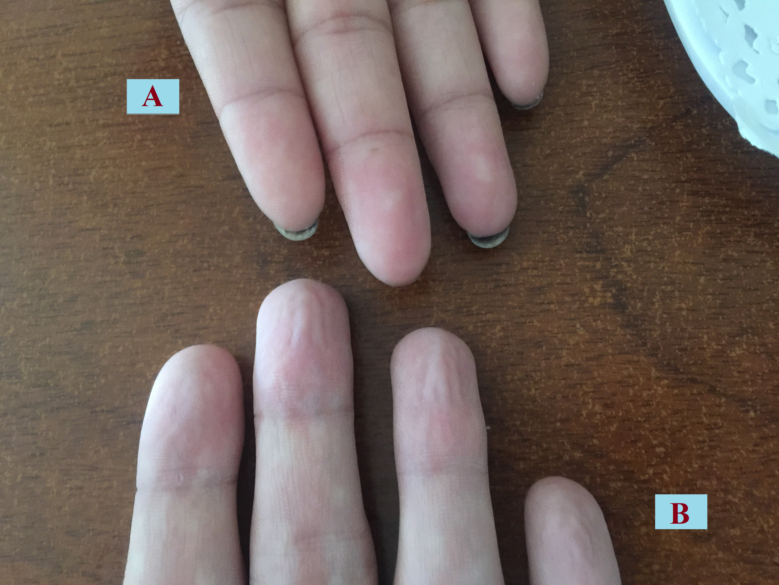
Imaging
Lucas Piedrafita Vico et al.
Notes:
Title: Water immersion wrinkling test
Legend: (A) Patient with small fiber neuropathy, (B) control subject. Both hands were immersed in water at 40°C for 30 minutes. A complete lack of wrinkles was observed in the patient (A) at the end of the test.

Slide 4
Absence of Wrinkles in Small Fiber Neuropathy
Normally, in the glabrous skin of the distal phalanges, water penetrates the sweat ducts provoking electrolytic changes that increase the firing of sympathetic terminals leading to vasoconstriction of the glomus bodies, generating wrinkles¹.
The damage of sympathetic fibers is responsible for the lack of wrinkles in small fiber neuropathies.
Two or fewer digital wrinkles is consistent with distal sympathetic dysfunction².
This test has a Sensitivity of 71% and a Specificity of 73%².
This is a simple, non invasive, frequently forgotten bedside test that does not require expensive equipment and contributes to the diagnosis of small fiber neuropathy.
Lucas Piedrafita Vico et al.
Notes:
1) Wilder-Smith EP. Water immersion wrinkling--physiology and use as an indicator of sympathetic function. Clin Auton Res. 2004;14(2):125-131. doi:10.1007/s10286-004-0172-4
2) Wilder-Smith EP, Guo Y, Chow A. Stimulated skin wrinkling for predicting intraepidermal nerve fibre density. Clin Neurophysiol. 2009;120(5):953-958. doi:10.1016/j.clinph.2009.03.011

