Slide 1
Resident & Fellow Section Teaching NeuroImage Brain calcification in a young girl with seizures
Bindu Menon et al.

Slide 2
Vignette
Refractory seizure since 10 years of age.
There was no history of any medication use for other illness, radiation exposure.
There were no neurocutaneous stigma.
Bindu Menon et al.

Slide 3
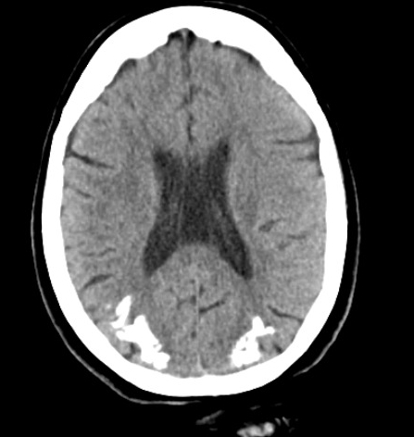
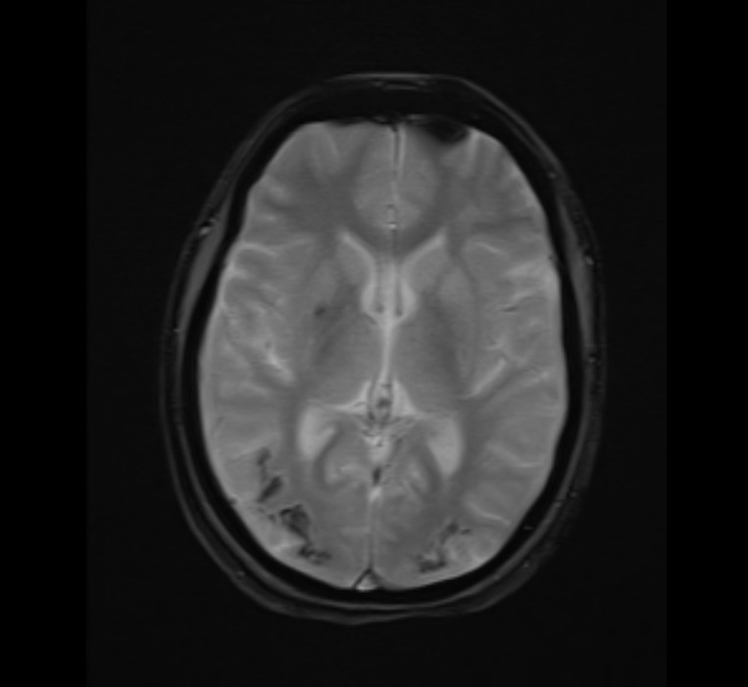
Imaging
Figure 1 A
Figure 1B
Bindu Menon et al.
Notes:
Figure 1A CT scan and Figure 1B MRI (GRE) showing bilateral cortical, subcortical calcification in parieto-occipital regions.

Slide 4
Brain calcification in a young girl with seizures- explore the rare differentials.
CT scan and MRI (GRE) showed bilateral cortical and subcortical calcification in parieto-occipital regions.
Based on imaging findings, Celiac disease Epilepsy Cerebral calcification syndrome (CEC syndrome) was considered.
This was confirmed by the presence of high antigliadin IgA (7.16U/ml), IgG (36.12 U/ml), and IgG tissue transglutaminase tTG (645 U/ml) levels. Interictal EEG showed generalised discharges.
Differentials were Sturge-Weber syndrome (SWS), congenital folate malabsorption, treatment with methotrexate and antifolate, and radiotherapy.
SWS was excluded due to the absence of facial nevus, lobar atrophy, and subcortical calcification on MRI.
Our patient had CEC syndrome with silent Celiac disease.
Bindu Menon et al.
Notes:
Gobbi G, Bouquet F, Greco L, Lambertini A, Tassinari CA, Ventura A, Zaniboni MG. Coeliac disease, epilepsy, and cerebral calcifications. The Italian Working Group on Coeliac Disease and Epilepsy. Lancet. 1992 Aug 22;340(8817):439-43. doi: 10.1016/0140-6736(92)91766-2. PMID: 1354781.
2. Sunnikutty A. P., Harding J., Nelson J. C. CEC syndrome–a rare manifestation of coeliac disease. Ulster Medical Journal. 2008;77(3):205–206.

