Slide 1

Resident & Fellow Section
Teaching Video NeuroImage
53 year old woman with incoordination and double vision
Bell et al.

Slide 2
Vignette
53-year-old woman presented with ataxia, dysarthria, and vertical binocular diplopia on left and right gaze but absent in primary gaze.
Symptoms progressive over several months without clear inciting event.
Initial neuro-ophthalmology evaluation showed subtle downbeat nystagmus in primary gaze that increased in horizontal gaze, consistent with ‘side-pocket’ phenomenon.¹
On cross-cover testing she was found to have an alternating skew deviation, raising question of cerebellar localization (Video 1).
Bell et al.

Slide 3
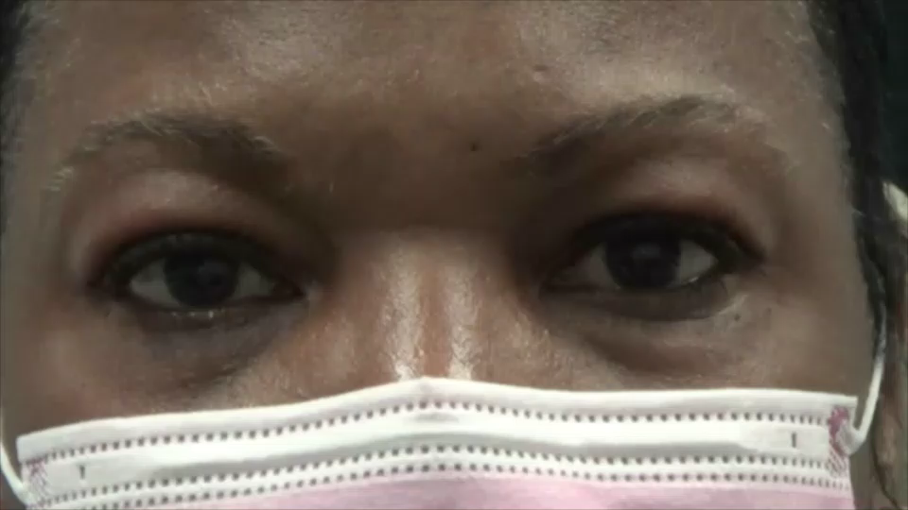
Imaging
Bell et al.
Notes:
This patient has an alternating skew deviation with 8 prism diopters right hypertropia in right gaze and 8 prism diopters left hypertropia in left gaze.

Slide 4
Title
Serum studies revealed elevated glutamic acid decarboxylase antibody (anti-GAD65) levels (>250.0 IU/mL, normal range 0-5.0 IU/mL).
She was diagnosed with anti-GAD65 cerebellitis.
Intravenous immunoglobulin may improve outcome.
Bell et al.
Notes:
1. Vestibular Nystagmus - an overview | ScienceDirect Topics. Accessed October 21, 2022. https://www.sciencedirect.com/topics/medicine-and-dentistry/vestibular-nystagmus
2. Budhram A, Sechi E, Flanagan EP, et al. Clinical spectrum of high-titre GAD65 antibodies. J Neurol Neurosurg Psychiatry. 2021;92(6):645-654. doi:10.1136/jnnp-2020-325275

