Slide 1
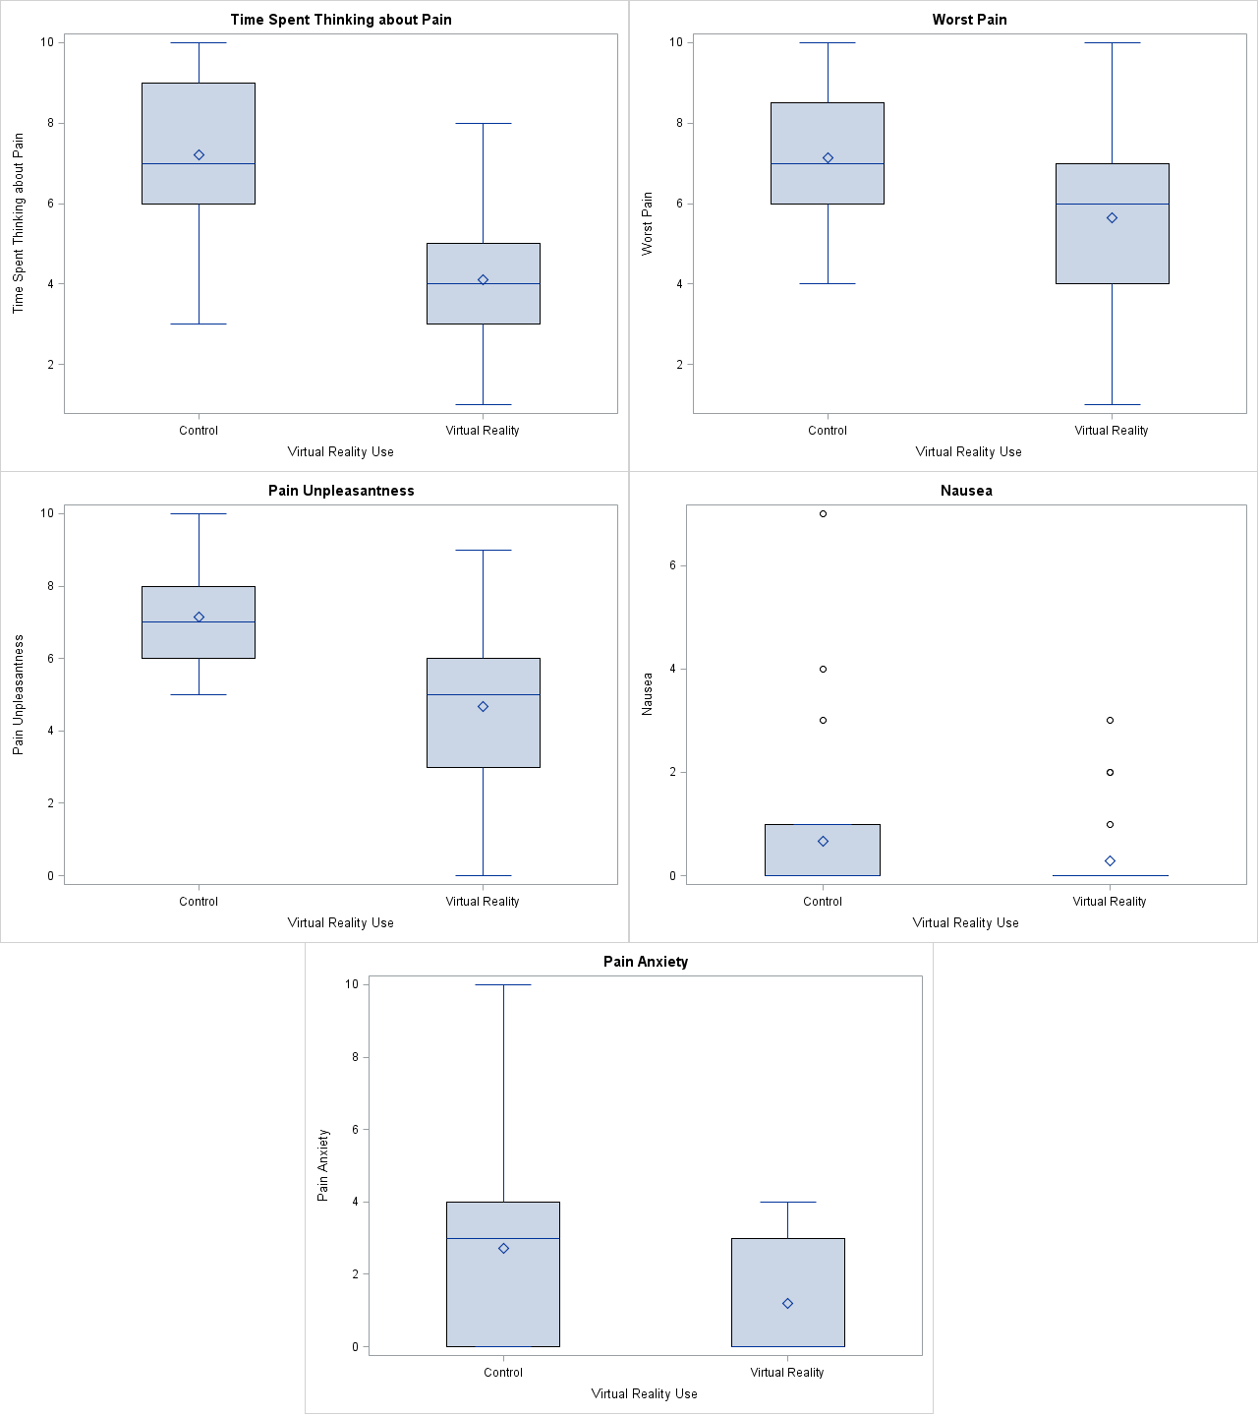
Supplemental Figure S1. Boxplots and histograms for the mean differences for pain, anxiety, and nausea.

