Slide 1
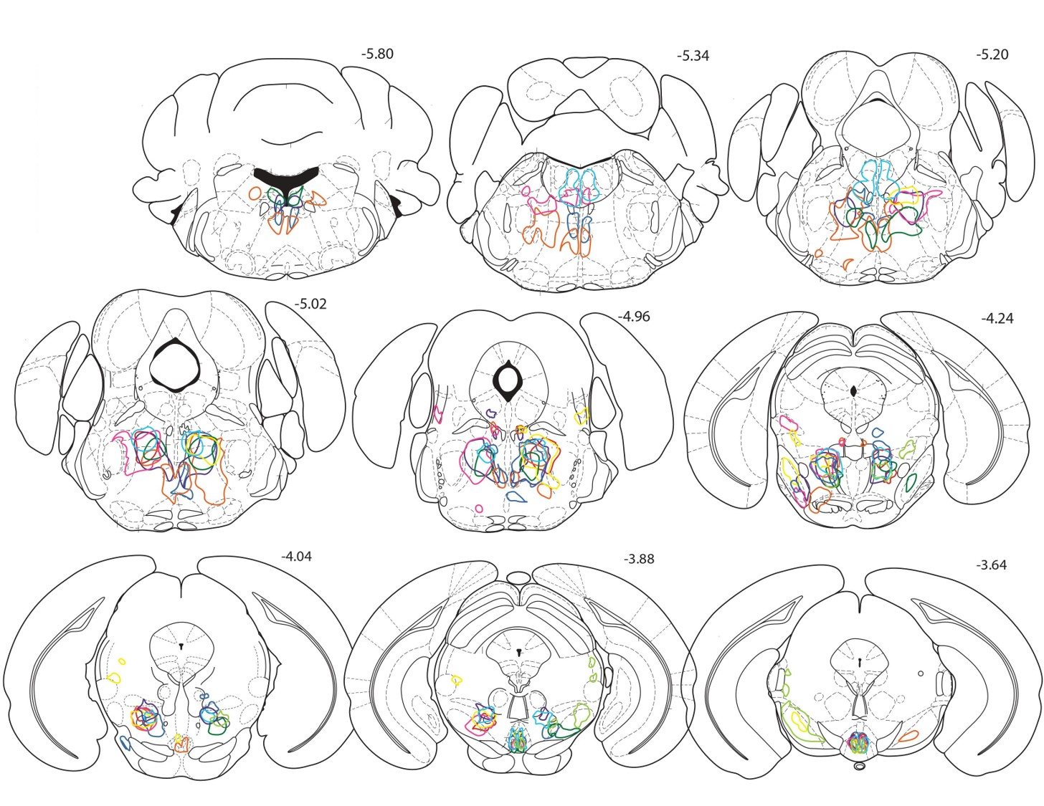
Distance from Bregma (mm)
Supplemental Figure 2
Coronal sections illustrating the extent of mCherry reporter expression for all hM3Dq mice. A different color was used for each mouse (n=9).

