Slide 1
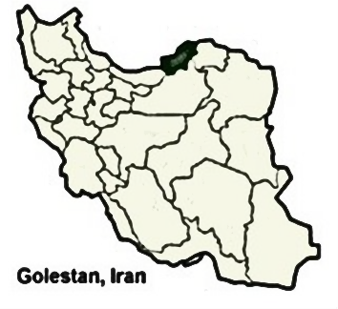
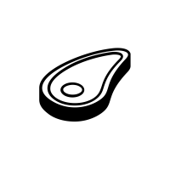
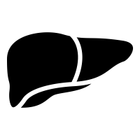
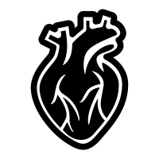
Red meat consumption and fatty liver disease
The Golestan Cohort Study enrolled 50,045 participants in Golestan Province, Iran.
A random sample of 1612 cohort members participated in a liver focused study
NAFLD was ascertained via ultrasound.
Red meat
OR _{Q4 vs Q1}=1.59, 95% CI=1.06 to 2.38
Organ meat
Healthy liver
OR _{Q4 vs Q1}=1.70, 95% CI=1.19 to 2.44
Fatty liver
Hashemian et al. Am J Gastroenterol. 2021.

