Slide 1
Supplementary Figure S1
796 patients with HCV-related compensated cirrhosis and EGDS within 1 year before DAAs
101 patients with HRV before DAAs
695 patients without HRV
103 patients did not undergo EGDS after DAAs
45 patients were lost at follow-up
119 patients without LSM by Fibroscan after DAAs
62 patients had previous history of HCC
13 patients with portal vein thrombosis
353 patients without HRV and with follow-up EGDS after SVR by DAAs
34 patients with progression to HRV

Slide 2
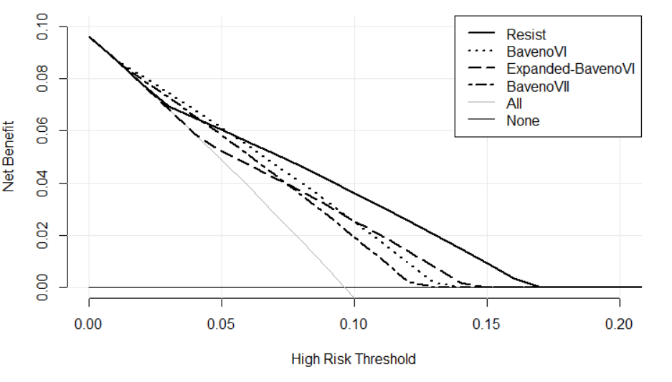
Supplementary Figure S2
10
8
6
Endoscopies correctly performed per 100 patients
4
2
0
Risk threshold of missing HRV (false negative)

Slide 3
Supplementary Figure S3
BAVENO VI IN (n=3)
BAVENO VI OUT (n=43)
HVPG before DAAs
HVPG after SVR by DAAs
HVPG before DAAs
HVPG after SVR by DAAs
p<0.001
p<0.001

Slide 4
Supplementary Figure S4
EXP BAVENO VI IN (n=20)
EXP BAVENO VI OUT (n=26)
HVPG before DAAs
HVPG after SVR by DAAs
HVPG before DAAs
HVPG after SVR by DAAs
p<0.001
p<0.001

