Slide 1
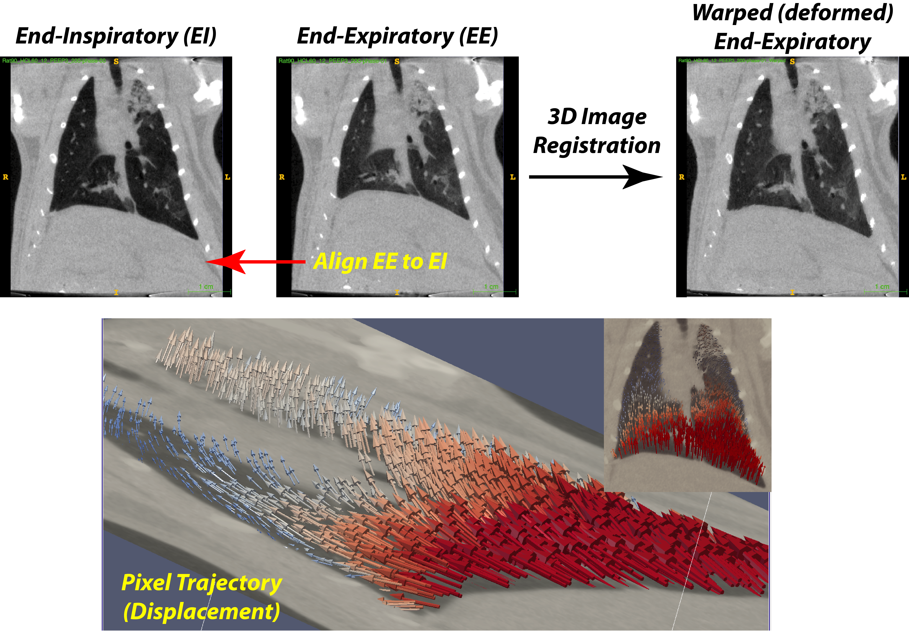
Thanks to registration, it is possible to track the displacement that each voxel undergoes during each tidal inflation. The trajectory of such displacement is indicated by vectors (arrows) and the color coding indicates the amount of the displacement. The voxels in proximity to the diaphragm undergo larger displacements along the cephalocaudal axis. Voxels in the upper lobes are mostly displaced in the dorsoventral direction (main panel), with larger vectors in proximity of injured tissue in the left upper lobe vs. the right upper lobe (insert panel).

