Slide 1
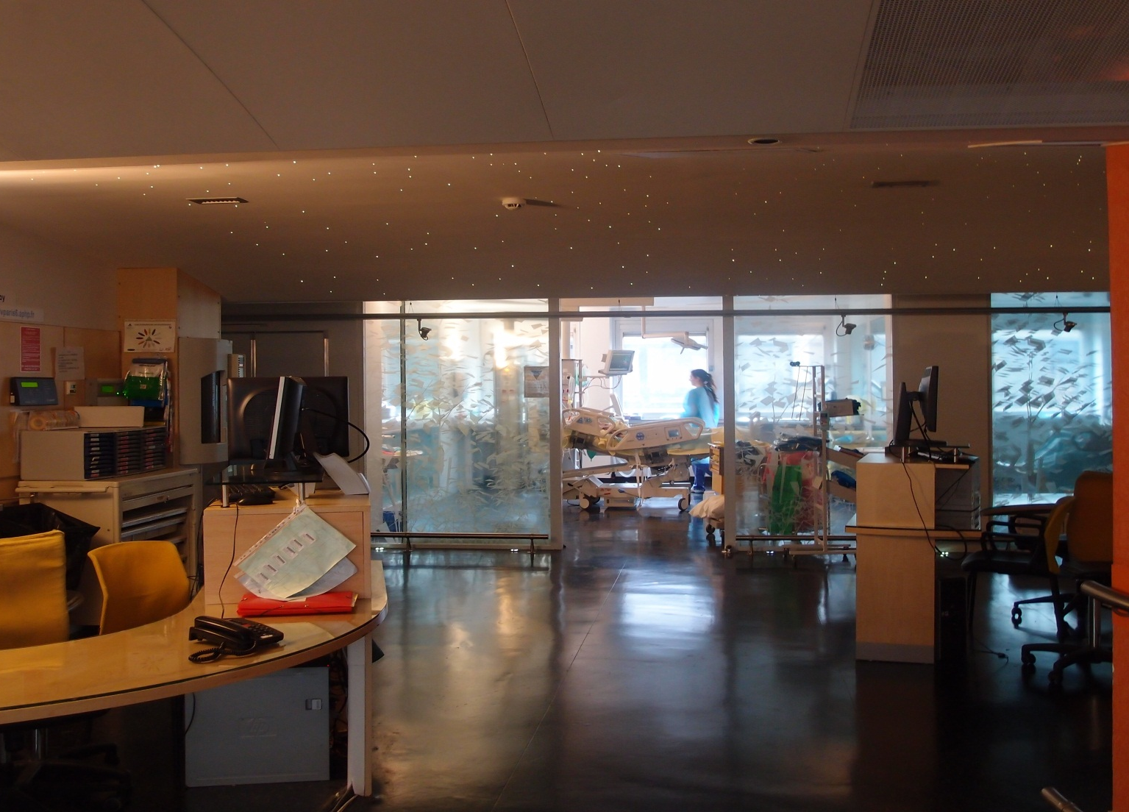
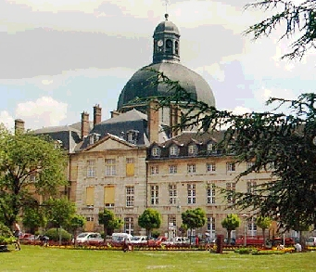
Basic skills in transthoracic lung ultrasound
Antoine Monsel, MD, PhD, Charlotte Arbelot, MD, Helene Brisson, MD, and Jean-Jacques Rouby, MD, PhD
Multidisciplinary ICU Department of Anesthesiology and Critical Care,
Pitié Salpêtrière Hospital, School of Medecine Sorbonne University, Paris, France
La Pitié-Salpêtrière
08 06 2012
Multisiciplinary ICU, Department of Anesthesiology, La Pitié-Salpêtrière Hospital, Sorbonne University, Paris France
JJR January 2020

Slide 2
Lung consolidation
Lung Ultrasound : complete loss of aeration
3
Lung consolidation is detected by lung ultrasound (4 et 5 MHz) as a tissue stru-cture with hyperechoïc punctiform images (static and dynamic air bronchograms) .
Multisiciplinary ICU, Department of Anesthesiology, La Pitié-Salpêtrière Hospital, Sorbonne University, Paris France
JJR January 2020

Slide 3
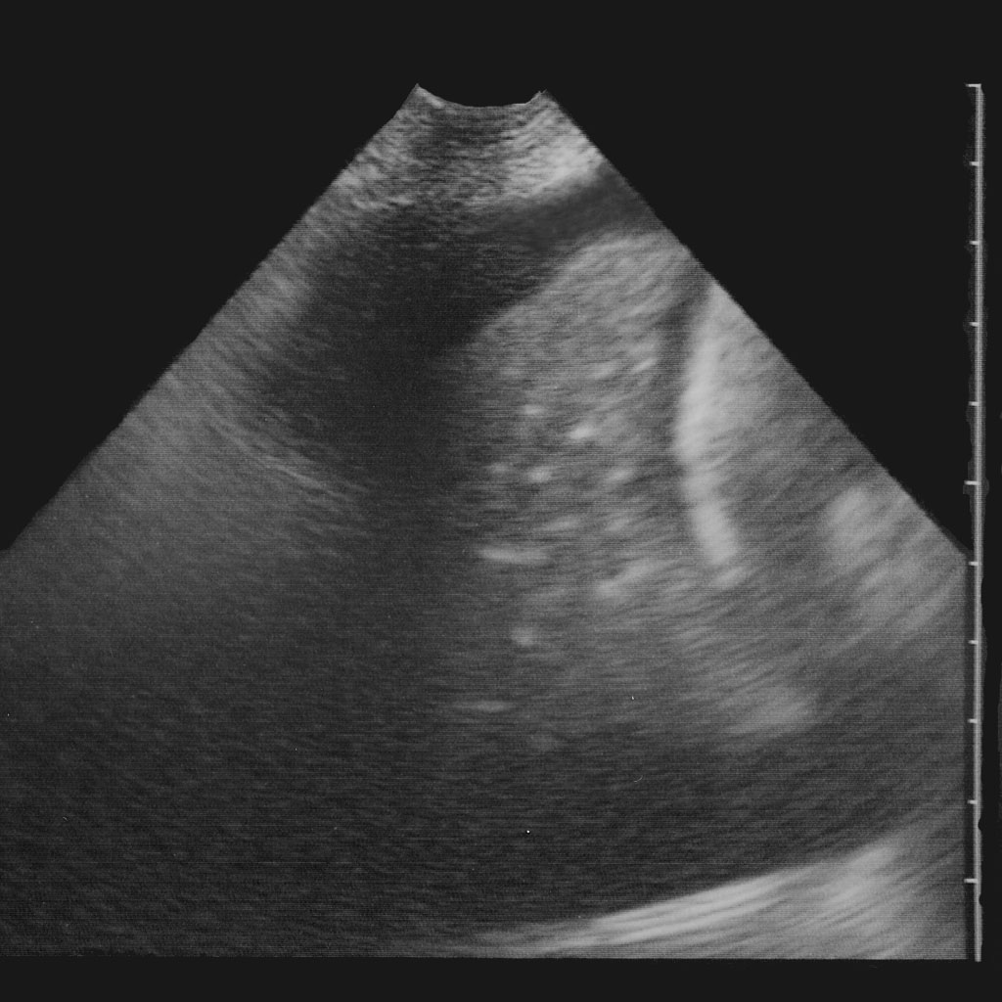
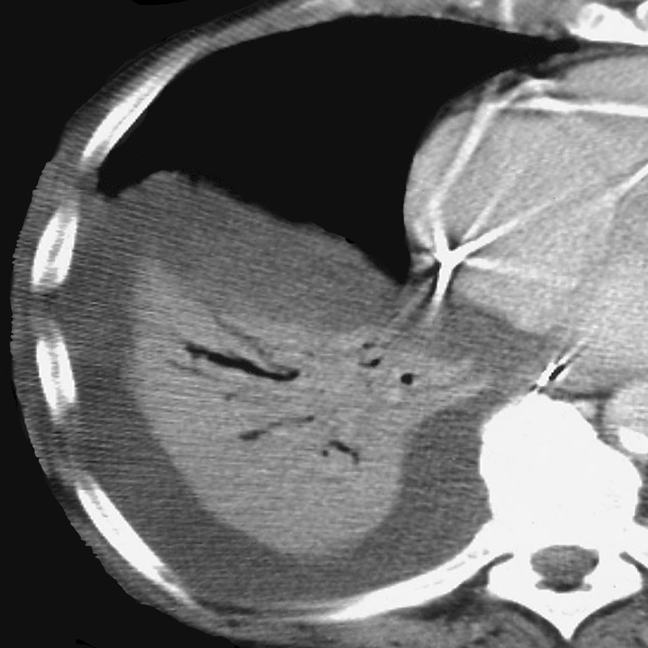
Pneumonia
Lung Ultrasound : complete loss of aeration
3
Presence of hyperechoïc punctiform images related to air bronchogram
Pleural effusion
Pleural effusion
Lower lobe
Lower lobe
Multisiciplinary ICU, Department of Anesthesiology, La Pitié-Salpêtrière Hospital, Sorbonne University, Paris France
JJR January 2020

Slide 4
Hyperechoïc punctiform images reinforcing at inspiration
Static air bronchogram
Multisiciplinary ICU, Department of Anesthesiology, La Pitié-Salpêtrière Hospital, Sorbonne University, Paris France
JJR January 2020

Slide 5
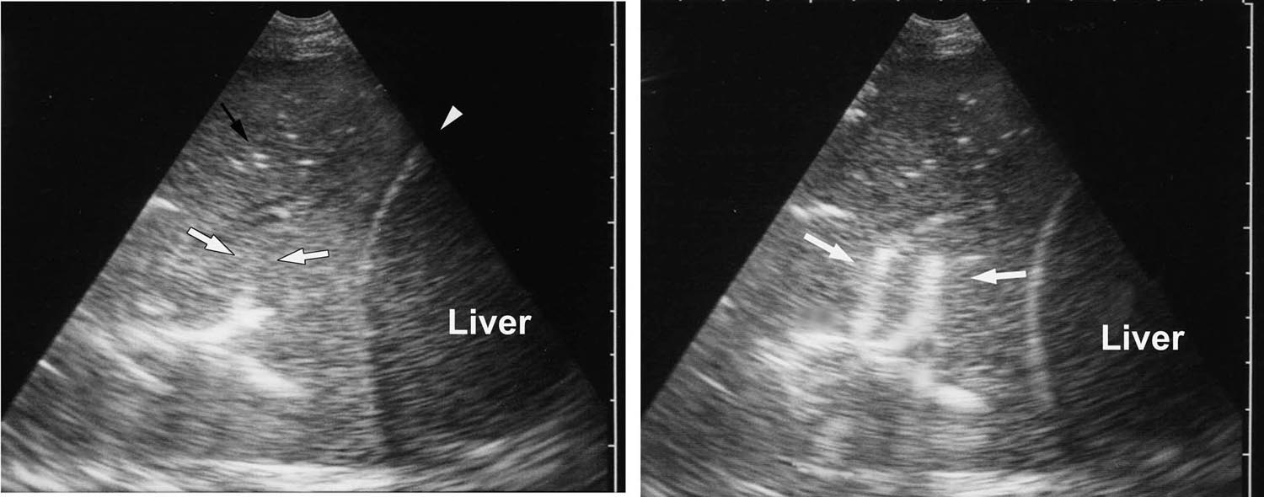
Tubular artifacts extending at inspiration (> 1 mm) BRONCHOPNEUMONIA
Dynamic air bronchogram
Lichtenstein Chest 135: 1421-1425, 2009
Multisiciplinary ICU, Department of Anesthesiology, La Pitié-Salpêtrière Hospital, Sorbonne University, Paris France
JJR January 2020

Slide 6
Dynamic air bronchogram
Purulent secretions moving within distal bronchi evocative of
pneumonia
Multisiciplinary ICU, Department of Anesthesiology, La Pitié-Salpêtrière Hospital, Sorbonne University, Paris France
JJR January 2020

