Slide 1
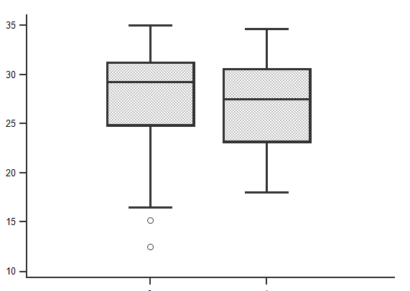
Importance of GI symptoms in COVID-19: A prospective study
Non-GI symptoms 18 (41%)
Non-GI + GI symptoms 15 (34%)
GI symptoms 1 1 (25%)
Mild-moderate COVID-19: 33
Severe COVID-19: 8
Critical COVID-19: 5
Patients with GI symptoms had a comparable load of viral RNA as evidenced by similar cycle threshold on reverse transcriptase (RT)-PCR
On multivariate analysis, the factors associated with the presence of GI symptoms included
Absence of contact history
Presence of non-GI symptoms
Comorbid illnesses
P=ns
Presence of GI symptom was a marker of more severe disease and fatal outcome on uni- & multivariate analysis
Ct value of N gene
GI symptom absent GI symptom present
Ghoshal UC et al. Clin Trans Gastroenterol. [Month 2020]. [doi]
.

