Slide 1
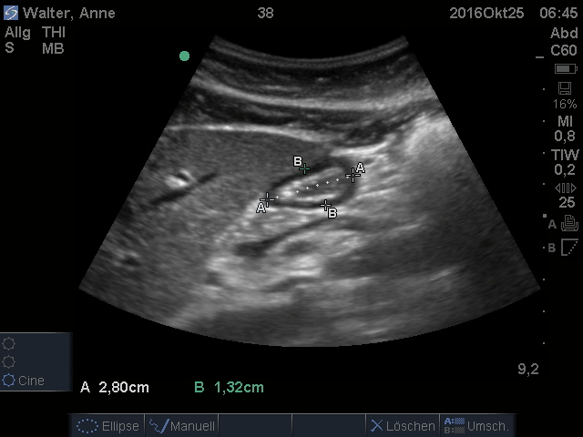
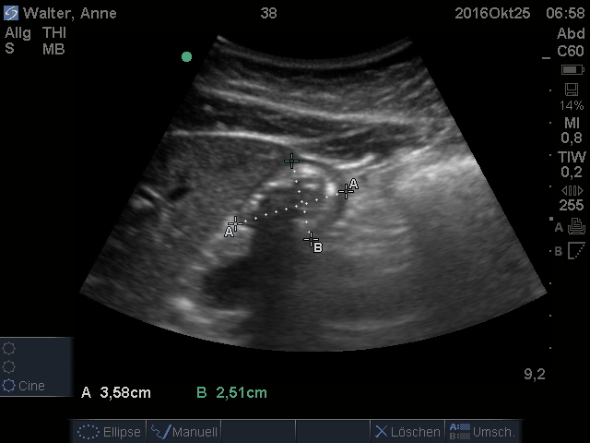
cranial
caudal
Gastric antrum
Liver
I
Smv
Aorta / Ivc
Sonographic view of the gastric antrum before (left side) and after gastric insufflation (right side). A and B represent the diameters of the cross sectional area (CSA) of the gastric antrum. Note the increase of the diameters A and B after gastric insufflation. Smv superior mesenteric vein, Ivc inferior vena cava, I intestine.

