Slide 1
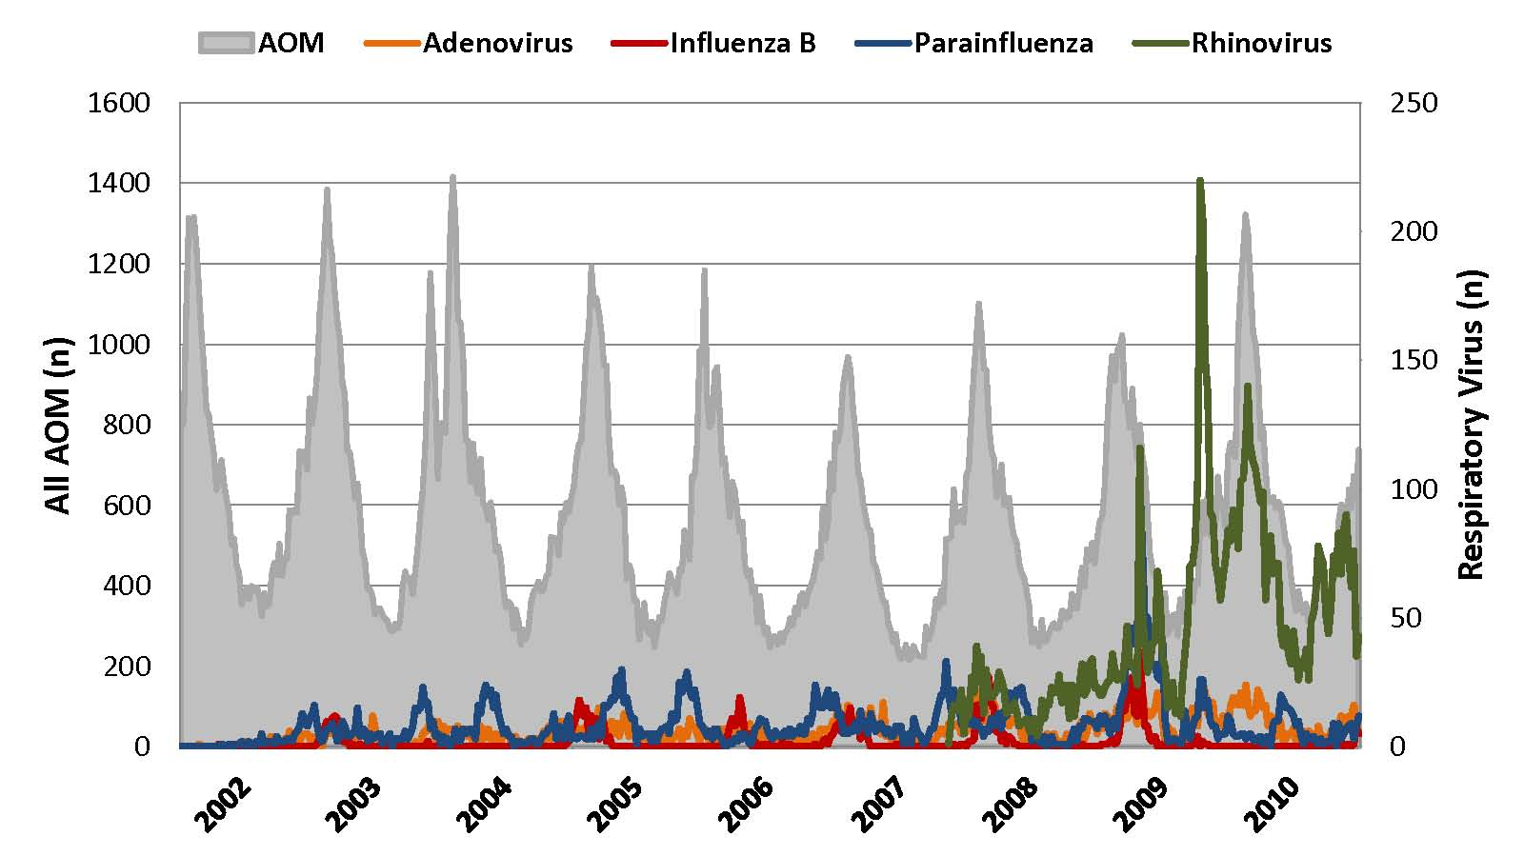
Supplement 2:Weekly relationship between ICD-9 coded acute otitis media (AOM) and adenovirus, influenza B, Parainfluenza, and rhinovirus among children younger than 18 years of age.

