Slide 1
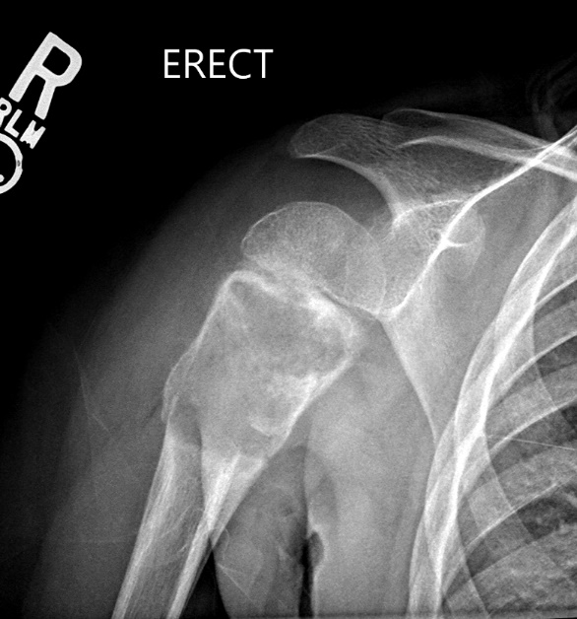
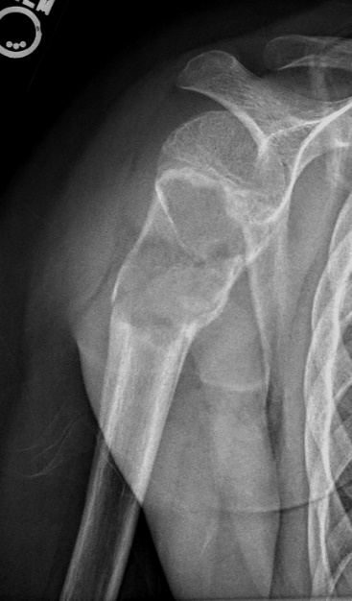
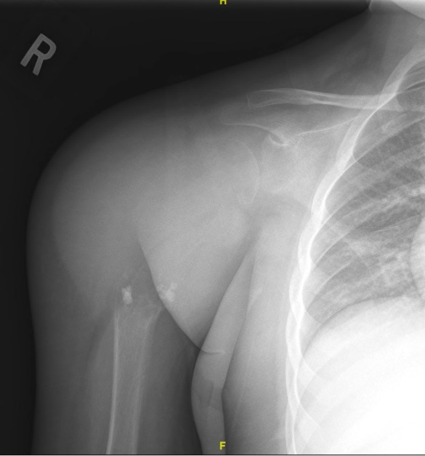
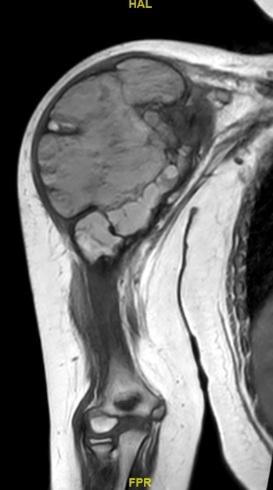
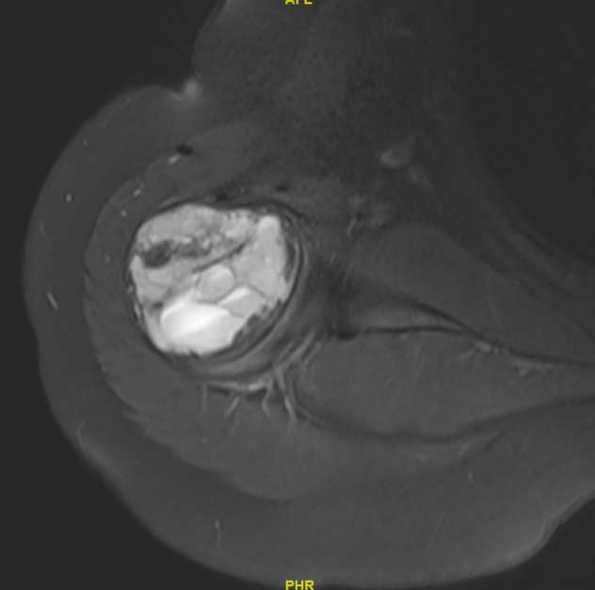
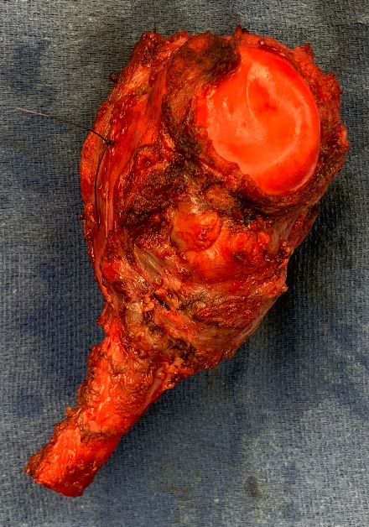
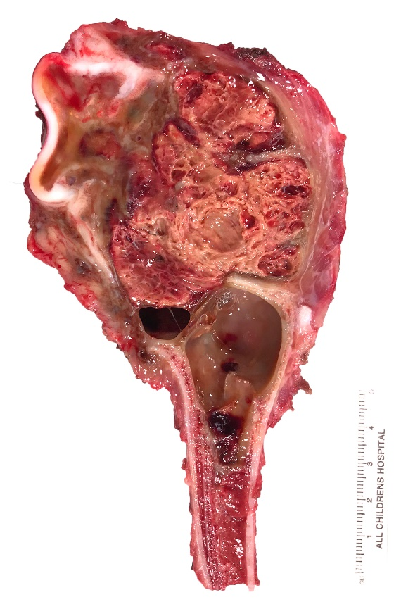
A
B
C
I
D
E
F
Telangiectatic Osteosarcoma: Unfortunately, telangiectatic osteosarcoma can mimic aneurysmal bone cysts due to their similar lytic and expansile radiographic appearance which may lead to delays in diagnosis. This young skeletally immature patient initially presented with a pathologic fracture through a suspected aneurysm bone cyst which can be appreciated on (A) AP and (B) lateral shoulder radiographs. C, several months later her tumor continued to grow and nearly completely destroyed her entire proximal humerus. There is a small amount of cloud-like, dense ossification within the mass distally which is evidence on this radiograph. D, coronal T1 and (E) axial T1 fat-saturated gadolinium enhanced images demonstrate a large, lobular mass within the proximal humerus with fluid-fluid levels present (white arrow). intact, but collapsed humeral articular surface can be appreciated an (F) intraoperative photograph of the resection specimen and on (G) gross pathologic evaluation of the cut specimen. With the latter, the complex and sometimes cystic characteristics of this tumor can be appreciated. These fluid-filled, cystic regions can make resection with negative soft-tissue margins difficult.
G
Notes:
Figure 4 Supplemental Digital Content

