Slide 1
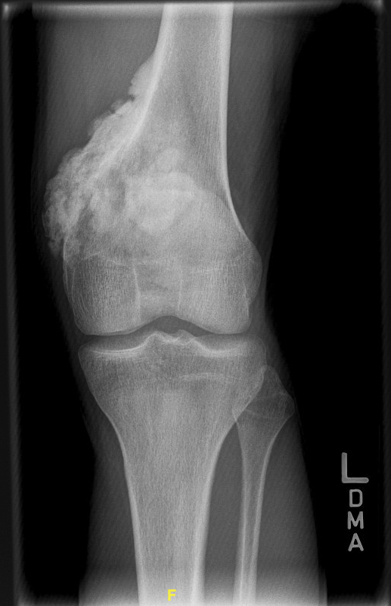
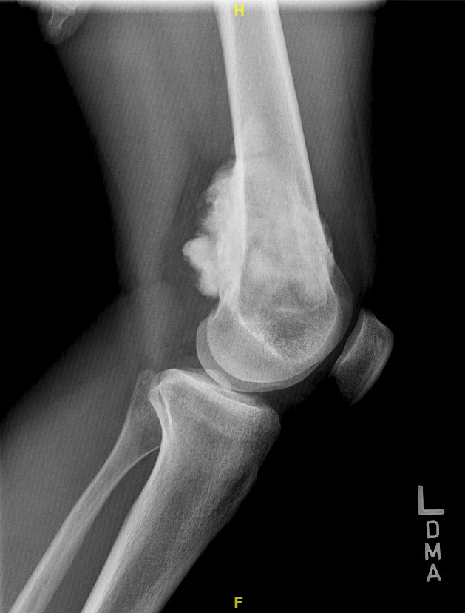
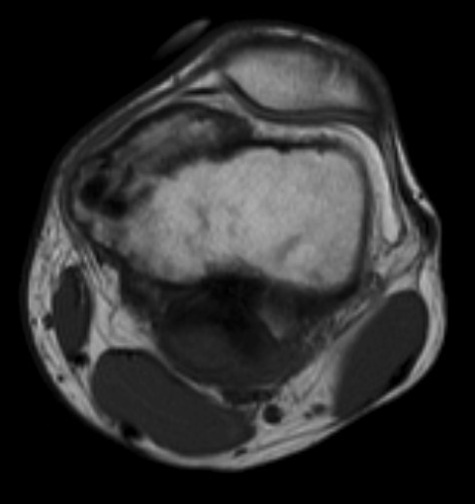
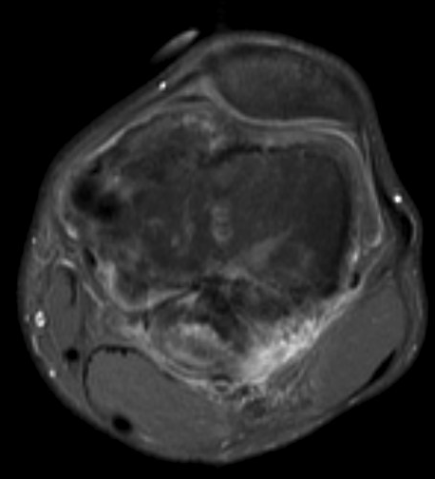
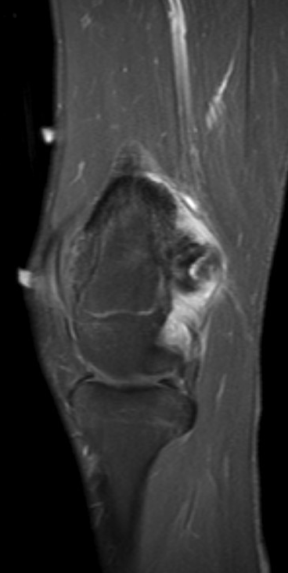
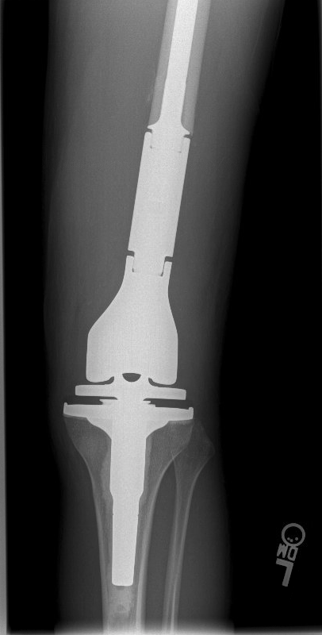
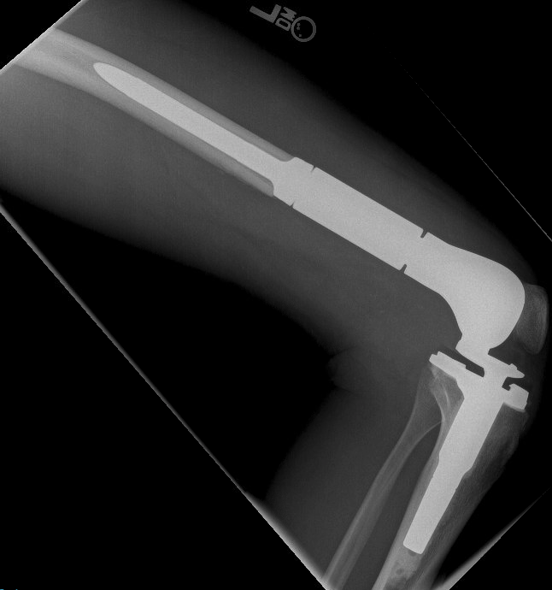
A
B
C
D
E
F
G
Parosteal Osteosarcoma: A, AP and (B) lateral radiographs demonstrate a dense, bone forming lesion with a stuck-on appearance arising from the posteromedial aspect of the distal femur. Axial MRI images, (C) T1 and (D) T1-fat saturated with gadolinium contrast enhancement, and a (E) sagittal T1-fat saturated gadolinium enhancement MRI image demonstrate a low signal intensity mass arising from the surface of the distal femur. F, AP and (G) lateral radiographs after distal femoral resection and endoprosthetic reconstruction with a rotating-hinge total knee arthroplasty.
Notes:
Figure 8 Supplemental Digital Content

