Slide 1
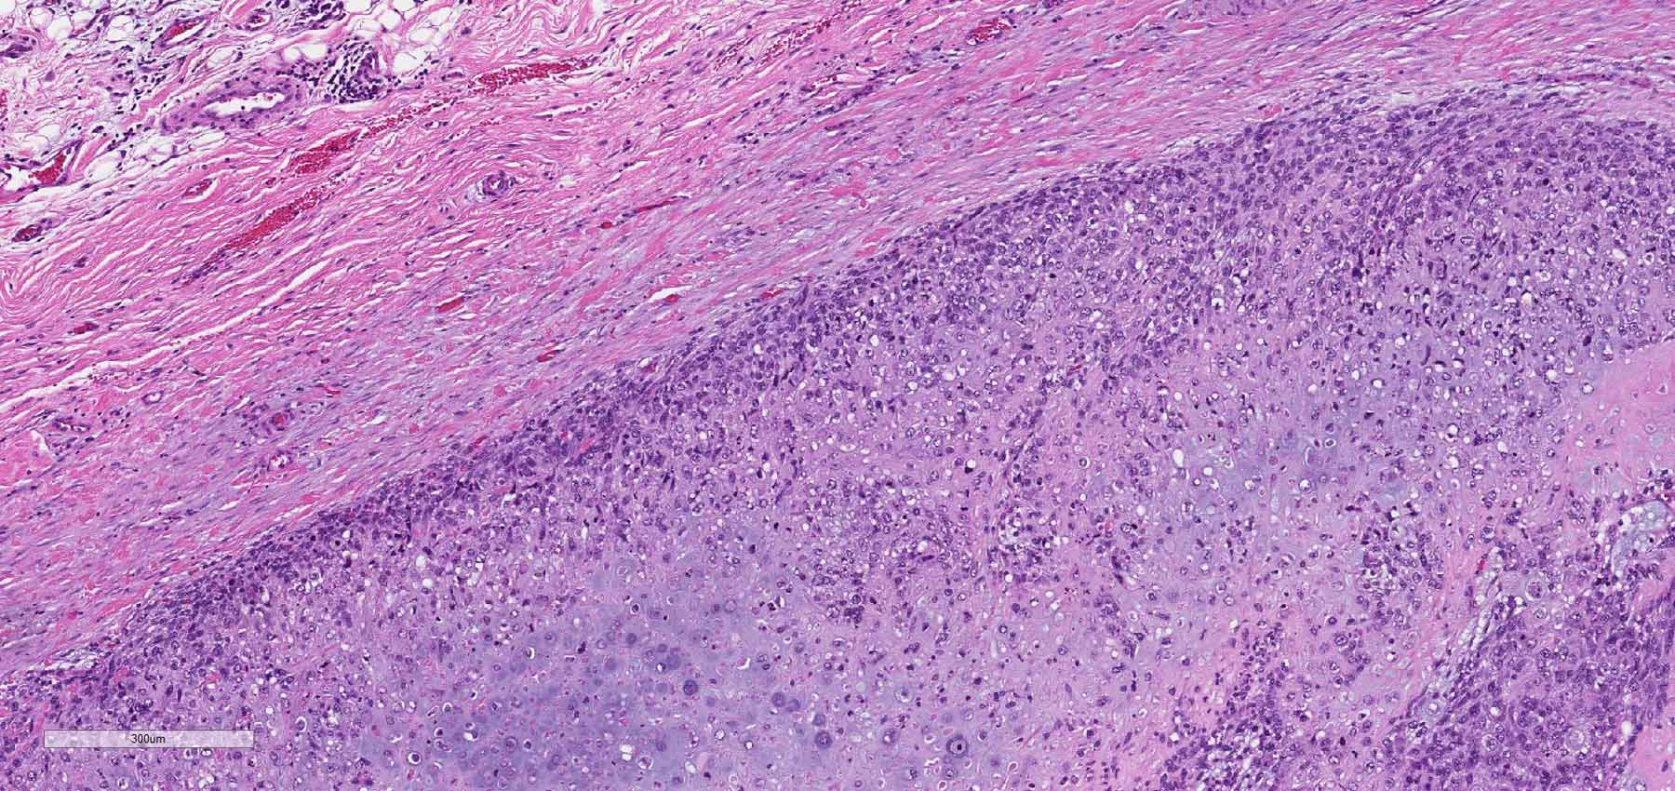
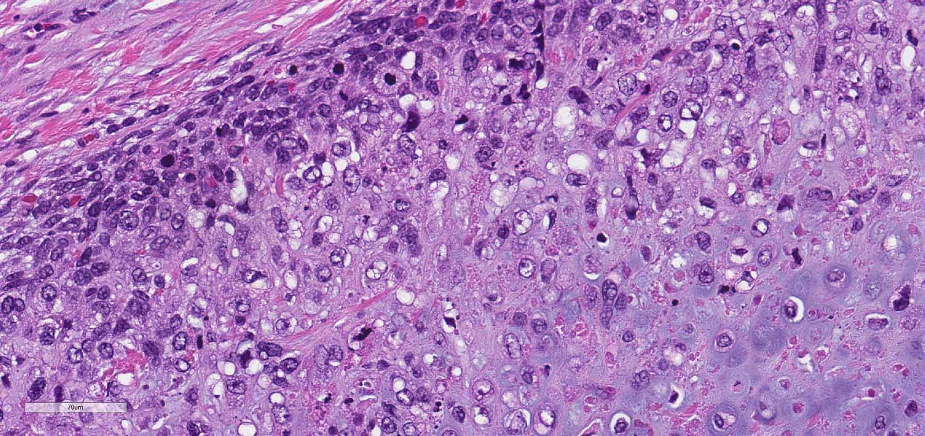
A
A
B
B
A, periosteal osteosarcoma with cartilaginous lobules of dominant chondroblastic osteosarcoma with highly atypical morphology and a peripheral condensation of spindle mesenchymal cells underlying dense collagenous tissue. B, higher magnification showing highly atypical, high-grade morphology of chondroblastic elements and a poorly-differentiated mesenchymal condensation of tumor cells along an outer lobular surface. Slides courtesy for Hector Monforte, MD of Johns Hopkins All Children’s Hospital, St. Petersburg, FL
Notes:
Figure 10 Supplemental Digital Content

