Slide 1
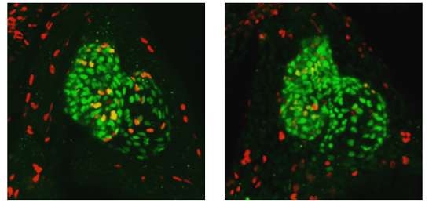
1% DMSO
15 µM Sertraline

