Slide 1
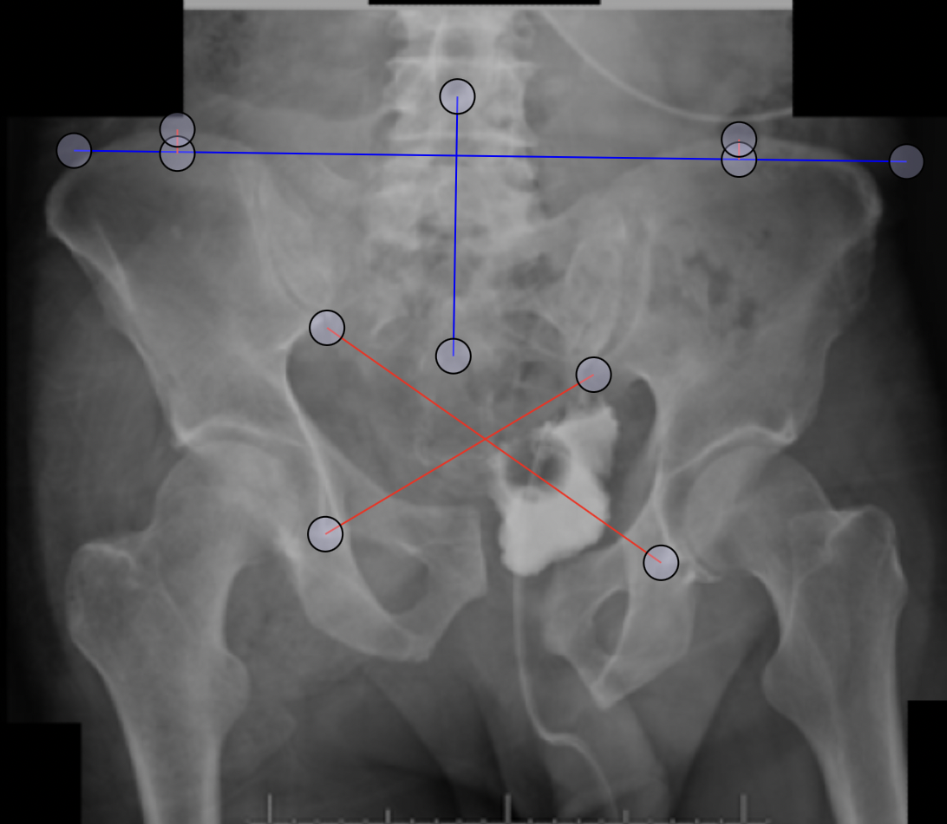
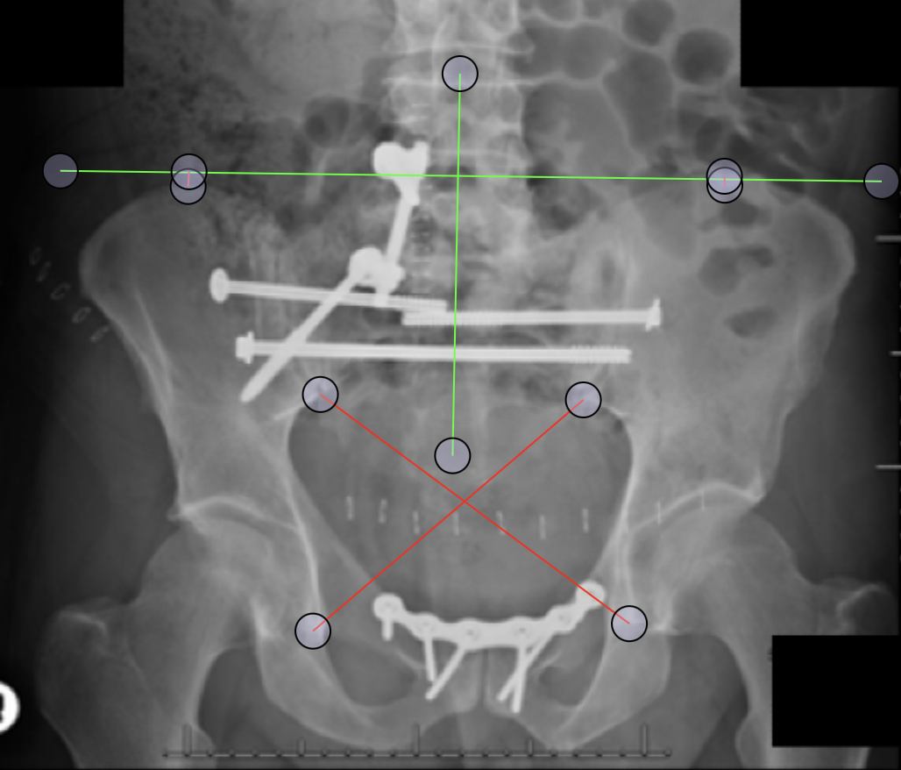
A
B
X
X
Y
Y
SD Content 2: Bonesetter APP images (https://detroitbonesetter.com/user/login, Detroit Michigan USA) with the modified Keshishyan index (X-Y)/(X+Y) and measurement of vertical displacement of the hemipelvis preoperatively (A) and postoperatively (B).

