Slide 1
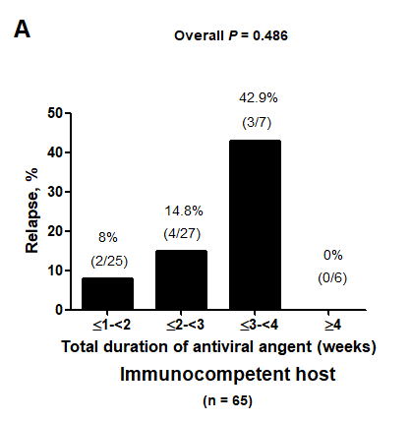
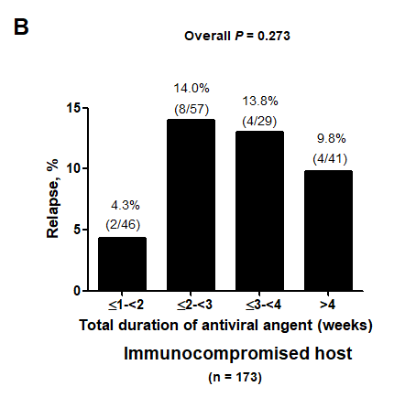
Supplementary Figure 2. Relapse rates of patients with GI CMV disease in immunocompetent host (A) and immunocompromised host (B) according to the total duration of antiviral treatment.

