Slide 1
OveRVIEW OF EMMA IPAD QUIZ-GAME

Slide 2
Medical staff enter patient information

Slide 3
Patient Entry (allows verification of patient knowledge of medications)

Slide 4
Choice of game environment

Slide 5
Game play (occurs between question sets)

Slide 6
IBD-specific questions given (12 questions from databank)

Slide 7
IBD-specific question (Example 2)

Slide 8
Feedback given with each question

Slide 9
IBD-related trivia given

Slide 10
Mental health questions given

Slide 11
Patient gives feedback

Slide 12
Patient results—iPad display

Slide 13
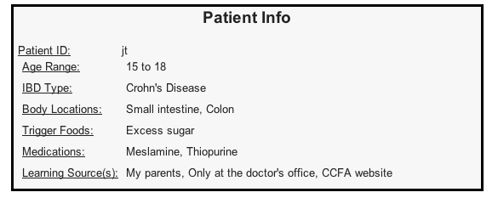
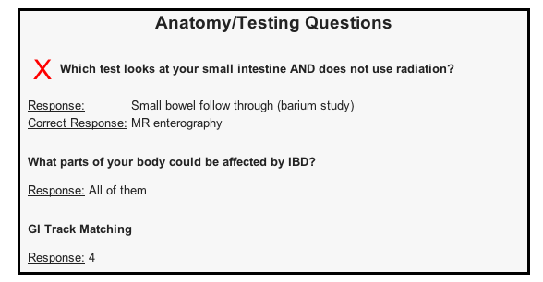
Patient results—email/paper display

