Slide 1
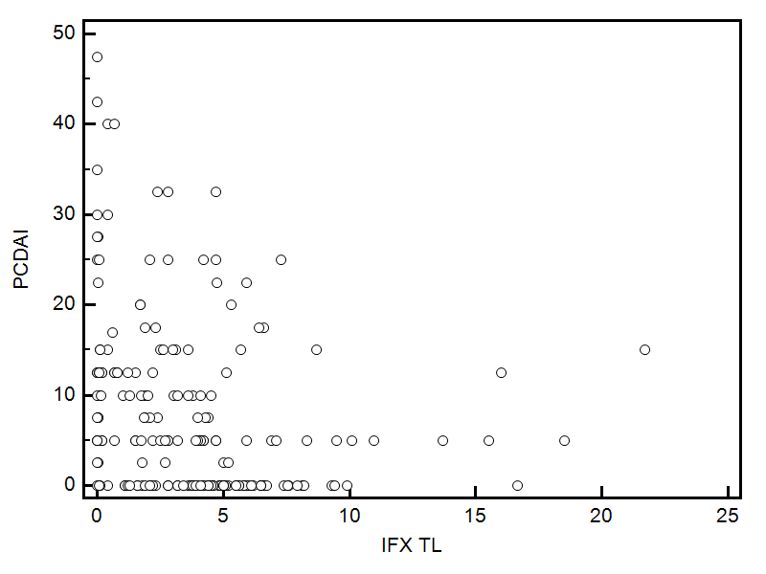
Supplemental Digital Content 1
Correlation between serum IFX-TL measurements and same point PCDAI scores showing significant negative correlation, Rho=-0.38, p<0.0001
IFX-TL - Infliximab Trough Level,
PCDAI - Pediatric Crohn’s disease activity index
P <0.0001, rho=-0.38

