Slide 1
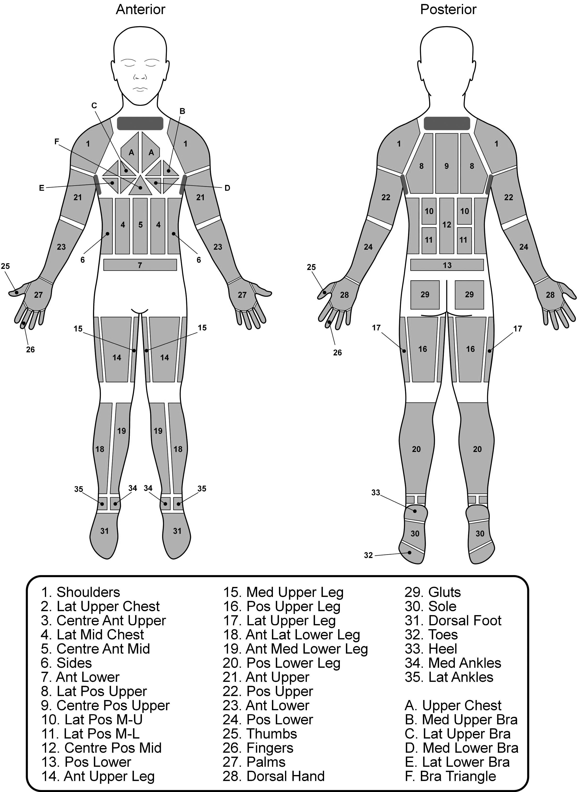
Supplemental Digital Content 2
Figure 1. Absorbent pad locations and labels for female sweat mapping. Note: Pads 2 and 3 are specific to male sweat maps due to differences in upper chest pads between sexes (See Smith and Havenith, 2011). Numbering has been kept constant between male and female sweat maps to allow easy comparison.

