Slide 1
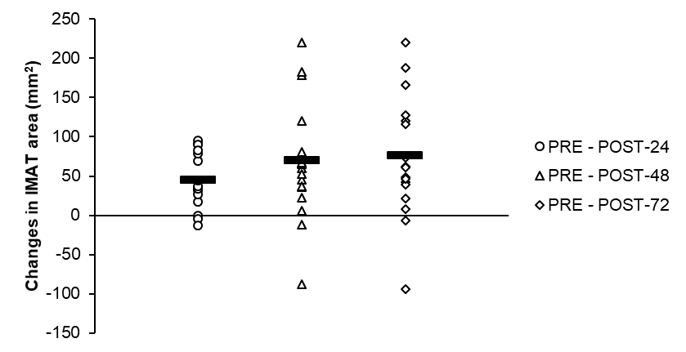
Figure 2. Changes in intermuscular adipose tissue (IMAT) area from PRE in the exercised limb following a bout of unilateral resistance exercise. Black strip (─) represents the mean of each comparison. Similar to muscle area, there was a significant difference between PRE and POST-24 and there were signs that IMAT area was continually increasing up to POST-72.

