Slide 1
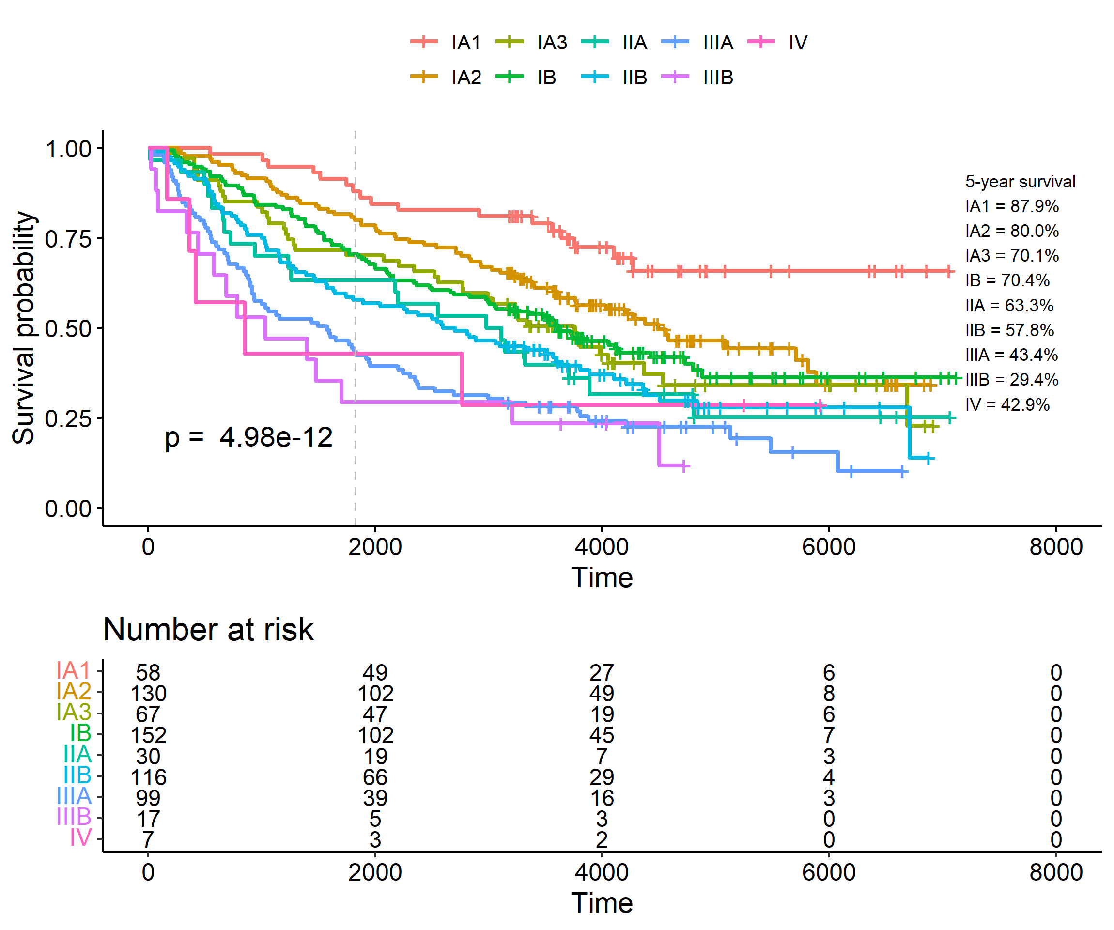
Supplemental Figure 1. Kaplan-Meier curves for overall survival based on pathological stages. The dashed vertical grey line represents the 5-year checkpoint.

