Slide 1
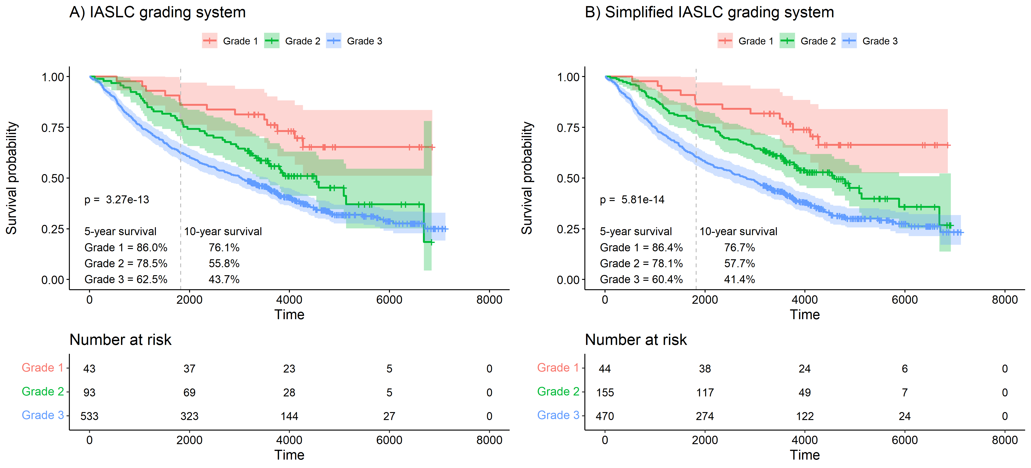
Supplemental Figure 2. Kaplan-Meier curves for overall survival in the discovery set without patients with pathological stage IV. A) The IASLC grading system where high-grade patterns include solid, micropapillary and complex glandular patterns. B) The simplified IASLC grading system where high-grade patterns include solid and micropapillary. The dashed vertical grey line represents the 5-year checkpoint.

