Slide 1
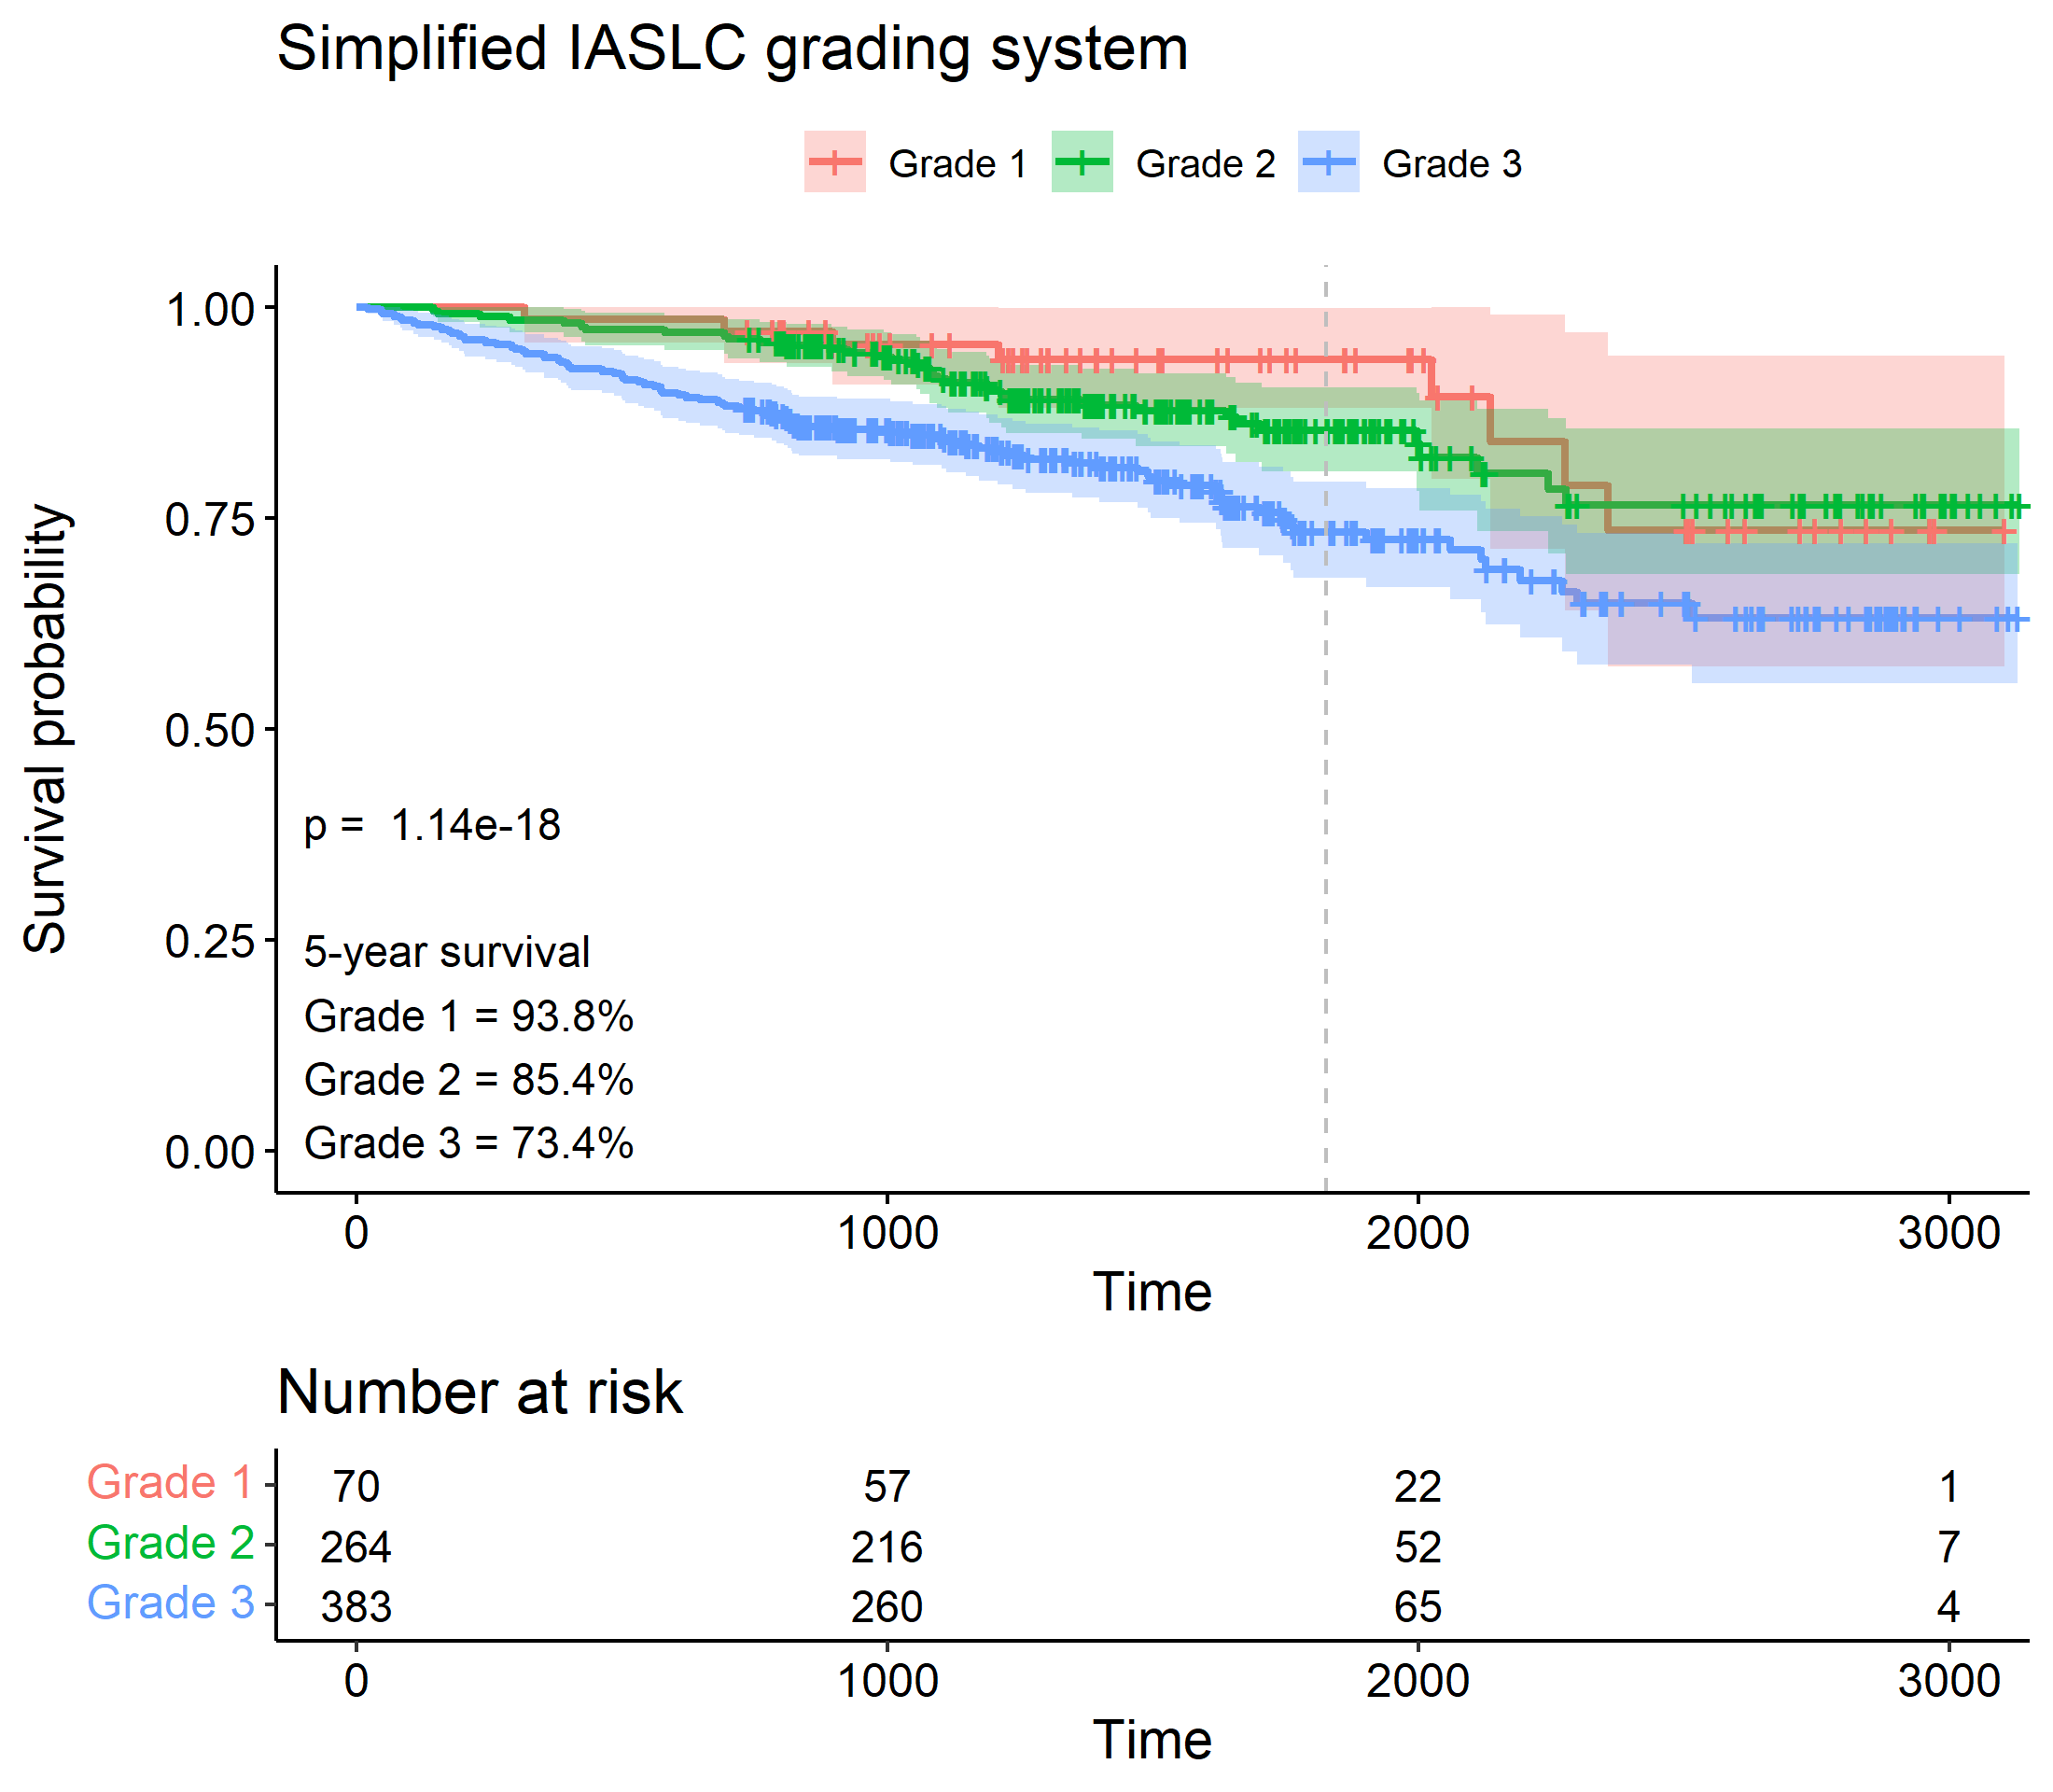
Supplemental Figure 3. Kaplan-Meier curves for overall survival based on the simplified IASLC grading system in the validation cohort. The dashed vertical grey line represents the 5-year checkpoint.

