Slide 1
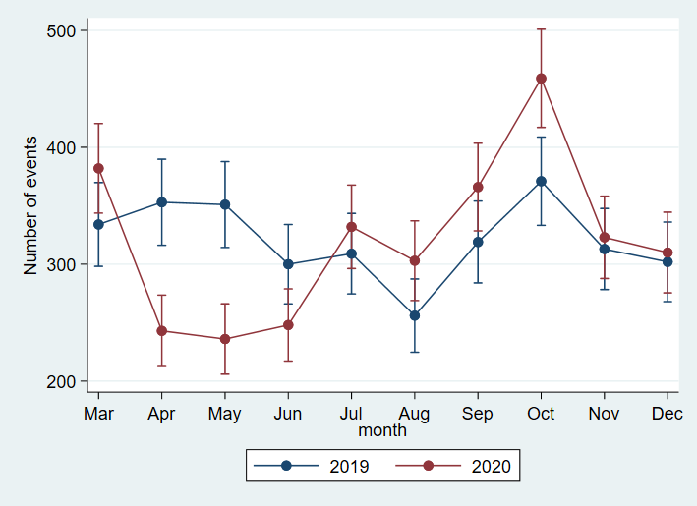
Supplementary Figure 1A. Number and 95% confidence intervals of hepatitis B surface antigen tests done per month.
Relative to the corresponding months of 2019, the number of HBsAg tests tests done per month in 2020 was significantly lower in April, May, and June and higher in August and November

Slide 2
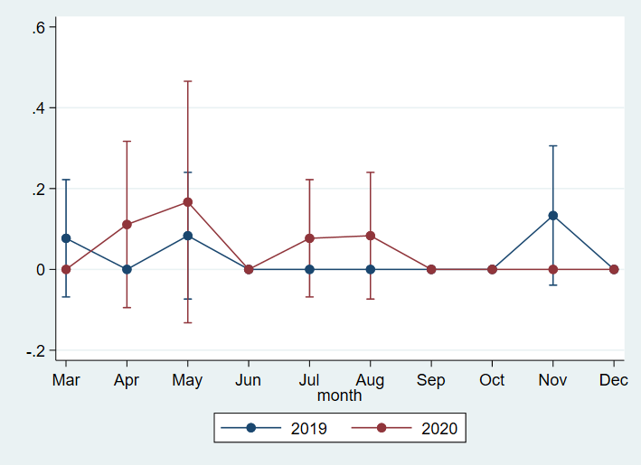
Supplementary Figure 1B. Proportion and 95% confidence intervals of de novo hepatitis B diagnoses per 100 hepatitis B surface antigen tests performed month.
Relative to the corresponding months of 2019, the proportion of de novo positive hepatitis B tests in 2020 was not significantly different in any month.

Slide 3
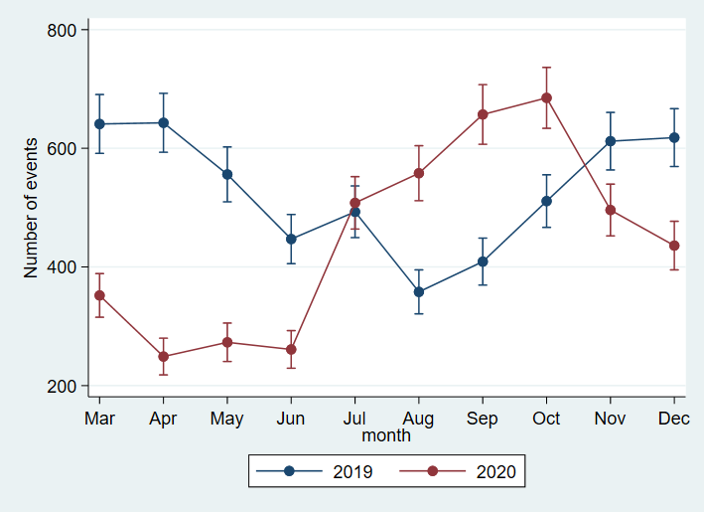
Supplementary Figure 1C. Number and 95% confidence intervals of hepatitis C antibody tests done per month.
Relative to the corresponding months of 2019, the number of hepatitis C antibodies done per month in 2020 was significantly lower in March, April, May, June, and November 2020.

Slide 4
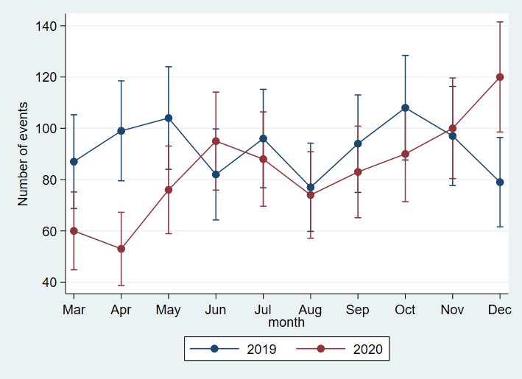
Supplementary Figure 1D. Number (and 95% confidence intervals) of hepatitis C RNA tests done per month.
Relative to the corresponding months of 2019, the number of hepatitis C RNA tests done per month in 2020 was significantly lower in March, April, and May, but it was significantly higher in December.

Slide 5
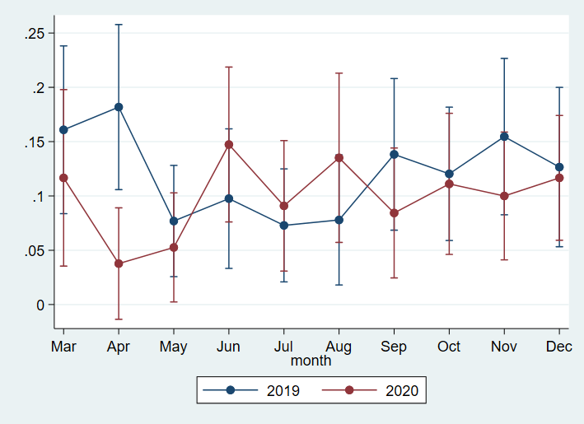
Supplementary Figure 1E. Proportion and 95% confidence intervals of de novo hepatitis C diagnoses per 100 hepatitis RNA tests performed month.
Relative to the corresponding months of 2019, the proportion of de novo hepatitis C diagnosed in 2020 was significantly lower in April 2020.

Slide 6
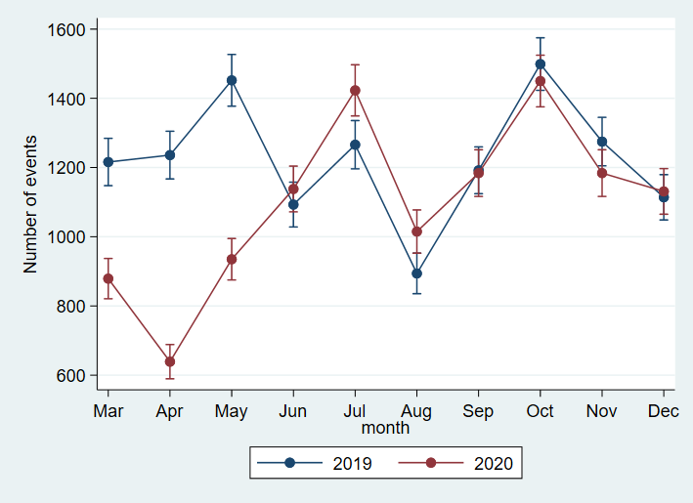
Supplementary Figure 2A. Number and 95% confidence intervals of VDRL tests done per month.
Relative to the corresponding months of 2019, the number of VDRL tests done per month in 2020 was significantly lower in March, April, and May, and significantly higher in July and August.

Slide 7
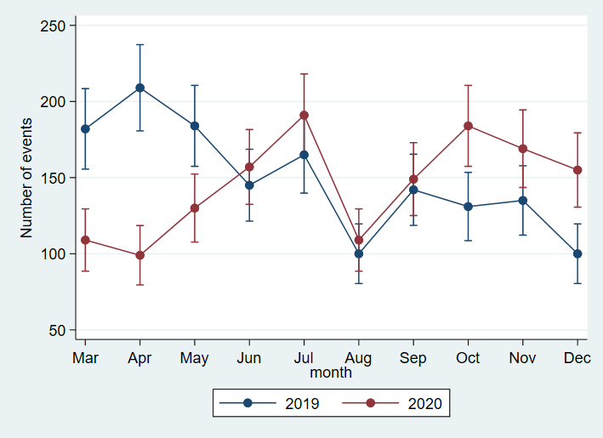
Supplementary Figure 2B. Number and 95% confidence intervals of Treponema pallidum IgM tests done per month.
Relative to the corresponding months of 2019, the number of IgM tests done per month in 2020 was significantly lower in March, April, and May, and significantly higher in October, November, and December.

Slide 8
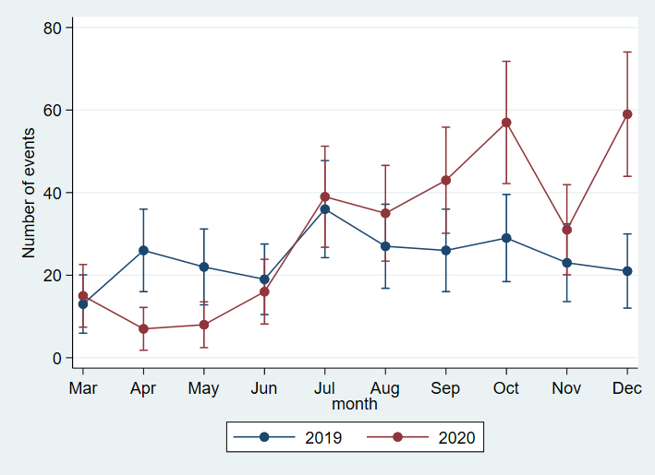
Supplementary Figure 2C. Number and 95% confidence intervals of Treponema pallidum PCR tests done per month.
Relative to the corresponding months of 2019, the number of Treponema pallidum PCR tests done per month in 2020 was significantly lower in April and May, and significantly higher in September, October, November, and December.

Slide 9
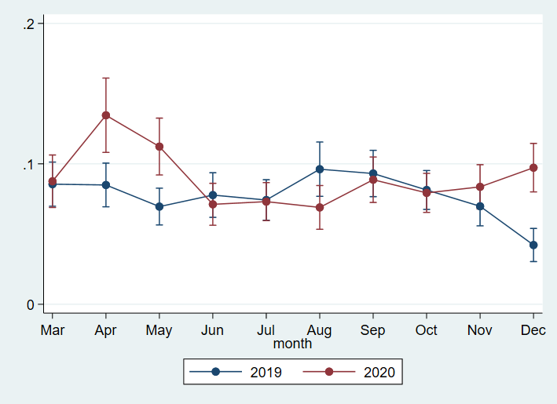
Supplementary Figure 2D. Proportion and 95% confidence intervals of de novo syphilis diagnoses per 100 syphilis tests performed month.
Relative to the corresponding months of 2019, the proportion of de novo syphilis diagnosed in 2020 was significantly higher in April, May, and December

Slide 10
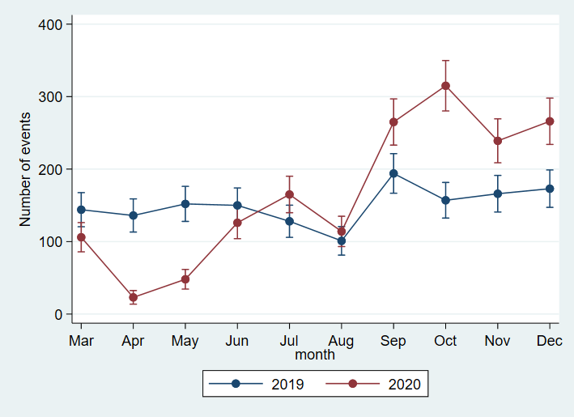
Supplementary Figure 2E. Number and 95% confidence intervals of Neisseria gohorrhoeae PCR tests done per month.
Relative to the corresponding months of 2019, the number of Neisseria gohorrhoeae PCR tests done per month in 2020 was significantly lower in March, April, and May, and significantly higher in July, August, September, October, November, and December.

Slide 11
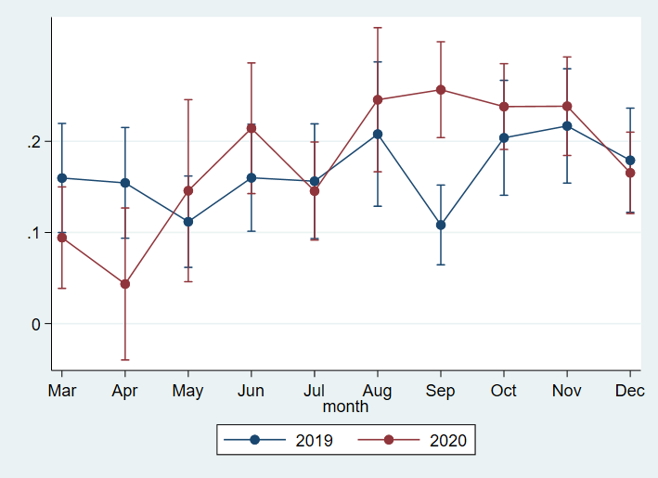
Supplementary Figure 2F. Proportion and 95% confidence intervals of de novo gonorrhoea diagnoses per 100 gonorrhoea tests performed month.
Relative to the corresponding months of 2019, the proportion of de novo gonorrhoea diagnosed in 2020 was significantly higher in September.

Slide 12
Supplementary Figure 2G. Number and 95% confidence intervals of Chlamydia trachomatis PCR tests done per month.
Relative to the corresponding months of 2019, the number of Chlamydia trachomatis PCR tests done per month in 2020 was significantly lower in March, April, and May, and significantly higher in July, August, September, October, November, and December.

Slide 13
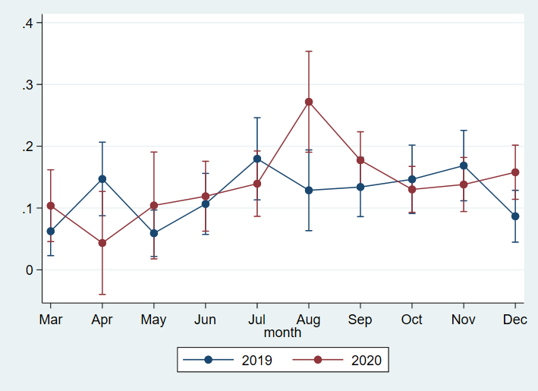
Supplementary Figure 2H. Proportion and 95% confidence intervals of de novo chlamydia diagnoses per 100 chlamydia tests performed month.
Relative to the corresponding months of 2019, the proportion of de novo Chlamydia trachomatis infections diagnosed in 2020 was significantly higher in August and December.

