Slide 1
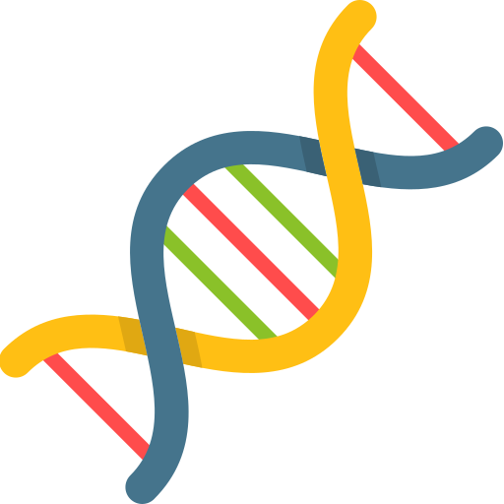
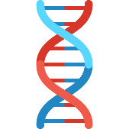
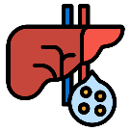
An integrated clinical and genetic prediction model for tacrolimus levels in pediatric solid organ transplant recipients
7 Canadian pediatrics
transplant centers
1 US transplant center
25 SNPs associated
with tacrolimus levels
8 SNPs significant
at genome-wide level
19 SNPs replicated in validation cohort
Significant interaction of age and organ type with rs776476*1 SNP (p<0.05)
455 discovery cohort
322 validation cohort
Top predictors
Age at transplant
rs776746
rs12333983
rs12957142
Lays the groundwork for an individualized age and organ specific genotype-guided approach to tacrolimus dosing
Min et al. Transplantation. Month 2020
@TransplantJrnl Copyright © 2020 Wolters Kluwer Health, Inc. All rights reserved

